Slide 1
Community Integration through Cooperative Education CICE Culinary Stream

Slide 2
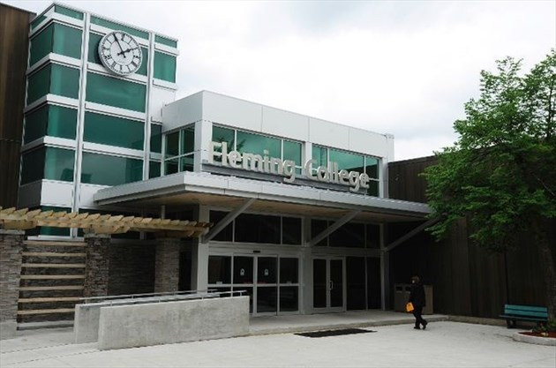
Introductions...
Tammy Christie Integration Facilitator Community Integration through Cooperative Education CICE Program Chef Steve Moghini RSE ADCO Chef, Professor, Program Coordinator Culinary Arts Jason Partridge Graduate 2016 CICE Culinary Stream

Slide 3
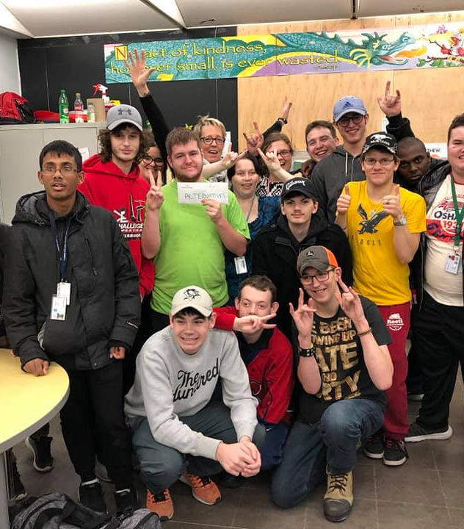
Focus on workplace skills and experience Two-year certificate program - CICE
Open to adults with Developmental Disabilities, Autism Spectrum Disorder, Intellectual Disabilities, Brain Injury and/or Mental Illness
Provides opportunity to continue post secondary education in an inclusive college environment.

Slide 4
“The Community Integration through Co-operative Education (CICE) program is designed to strengthen essential skills for work, life and learning”
Enhances active participation in the community; Field Placement, Community Events – One Roof
Development of essential skills through participation in strong academic programs
Building workplace skills through co-op placements where students receive on-the-job training from leading employers in the Peterborough area.
Justin Patterson
CICE Graduate Student, Business Stream
Owner “Justin Patterson Photos”
www.justinpattersonphotos.com

Slide 5
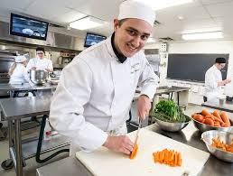
CICE Culinary Stream
CICE Culinary stream at Fleming College has provided inclusive learning opportunities for CICE students since 2011. Goals and outcomes include:
Participation in inclusive, practical hands on learning experiences in a full production lab, Fulford’s Deli or Fulford’s Bistro
Applying basic food and bake theories to food preparation courses
Contributing to a healthy, safe and well-maintained food service environment by applying principals of Basic FST Training
Working effectively as a member of a food service team
Development of transferable skills

Slide 6
Advanced Certifications…..
Students successful in the CICE Culinary Stream will graduate with certifications in: BASIC FST - Food Safety Training through TrainCan INC
Culinary Stream students complete and online course and complete and examination based on the Canadian Food Retail and Food Services Regulations and Code, Health Canada and CFIA (Canadian Food Inspection Agency)
Image: http://www.traincan.com/

Slide 7
Advanced Certifications…..
Students successful in the CICE Culinary Stream will graduate with certifications in: SMARTSERVE Culinary Stream students complete an approved educational program created by the Alcohol and Gaming Commission of Ontario (AGCO) as the only responsible alcohol training program for Ontario.
Image: https://smartserve.ca/

Slide 8
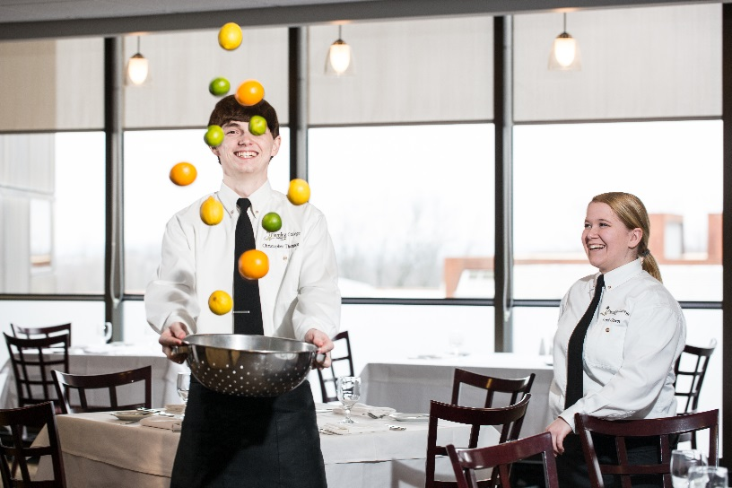
Advanced Certifications…..
Why is this important….
Required outcome for students taking Culinary based courses
Required licenses for students working in production labs, Fulford’s Bistro, Fulford’s Deli
Universal design for students crossing over into modified elective courses
Students leave with licenses that can added to resumes for employment after college

Slide 9
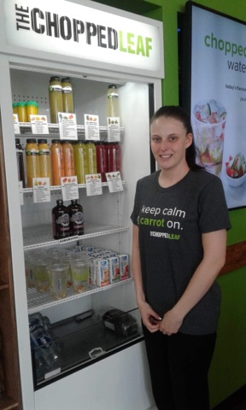
BLAIR’S STORY ...
Graduate, CICE Culinary Stream 2017
Completed 2 year certificate program
Successful in Basic Safety Training certification - TrainCan
Successful in Smart Serve Certification
Obtained employment outside of Peterborough
“Being in the Culinary Stream has allowed me to move into an environment where there are many opportunities to follow my dream of working in the culinary field”

Slide 10
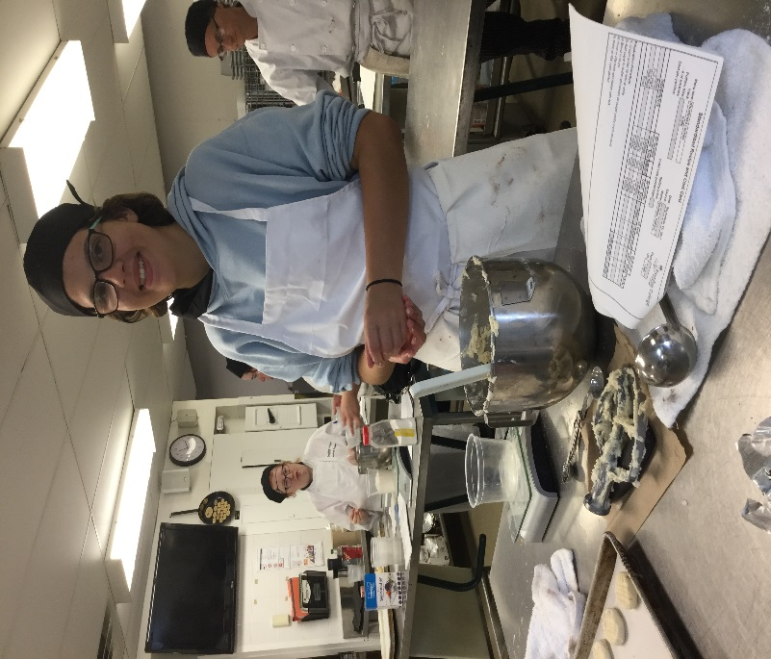
GRADUATE SUCCESS
Options vary from a cook (BOH) in a restaurant or institutional setting (long term care facility) to FOH table services
Line Cook
Sous Chef
Kitchen Assistant
FOH Restaurant Service
Dish Pit Operation
Food prep
Volunteer work at a School breakfast club

Slide 11
Success Rate
Kitchen Assistant- Ricky’s All Day Grill
Line Cook – Aramark Food Services
Prep Cook – Holiday Inn
Prep Cook, Customer Service – The Chopped Leaf
Prep Cook & Server - East Side Marios

Slide 12
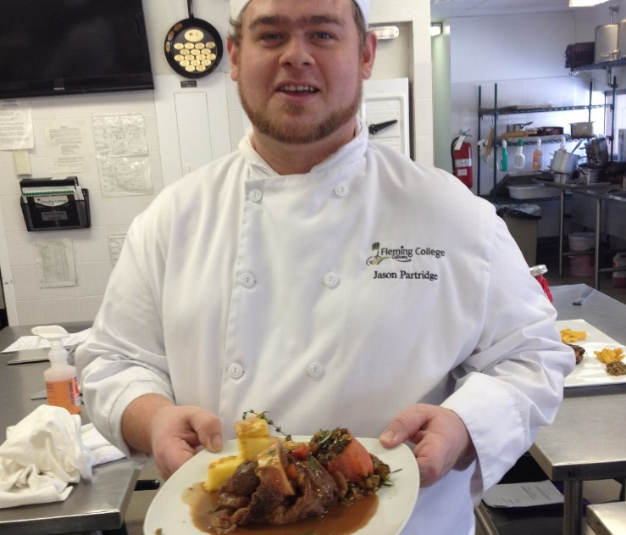
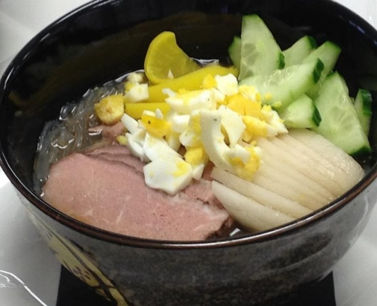
Jason’s Success Story… Graduate CICE Culinary Stream 2016
Introduction
Welcome to the CICE Culinary Stream!
Supports at college accessed in your journey
My Success Story – Life after college
Future Goals!

Slide 13
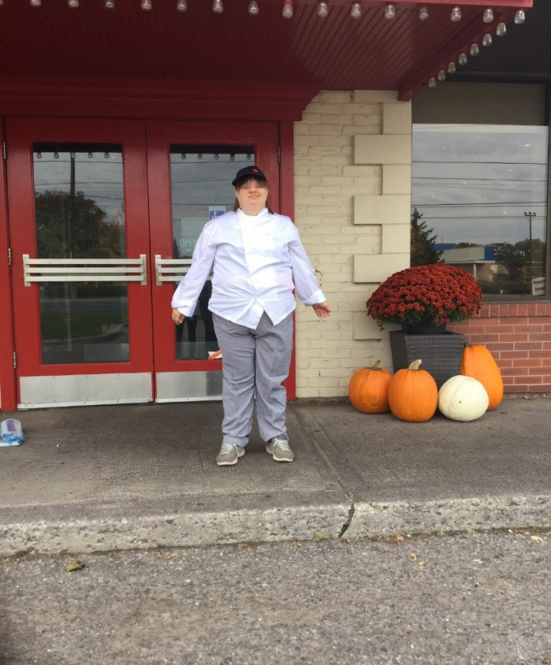
Kate’s Story….
CICE Culinary Stream Graduate 2019
Successful with Basic FST certification - TrainCan
Successful with Smart Serve certification
Employed part-time, Prep Cook & Server – East Side Marios

Slide 14
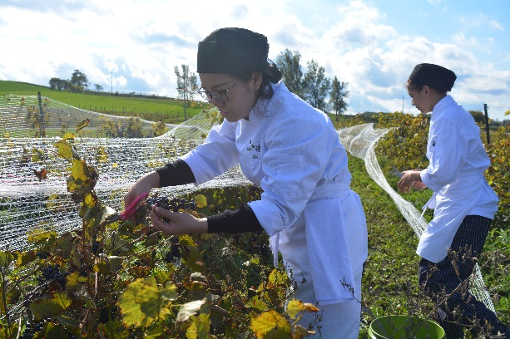
Culinary Faculty/Coordinator Perspective
Promoting students with disabilities with a sense of belonging
Social values
Community contribution
Learning that leads to independence
Sustainable employment in the culinary industry
Looking beyond the CICE certificate
Academic Upgrading
Culinary Skills program application – Pathway to Success / Transferable Skills

Slide 15
Kristin’s Story … Graduate, CICE Culinary Stream 2018

Slide 16
Benefits to the Culinary Program and culinary students:
Promotion of social values
Promotion of soft skills
Promotion of integrity and honesty values
Expectations
Differentiated pathways
Benefits to Employers

Slide 17
Fleming College CICE
+
=
Tammy Christie
Community Integration Through Cooperative Education (C.I.C.E)
Fleming College Telephone: 705-749-5520 Ext. 1237
tammy.christie@flemingcollege.ca
Office: A-1117.5
Steve Moghini RSE ADCO
Culinary Programs Coordinator, Chef/Professor
Fleming College
Telephone: 705-749-5520 x1725
steve.moghini@flemingcollege.ca
Office: A3115.7

