Slide 1
Mental Health in the Workplace
Simple strategies for wellness.

Slide 2
Speaker
Jack Veitch
Manager of Community Engagement and Education
Canadian Mental Health Association HKPR
@CMHAEducation

Slide 3
Purpose
To learn more about mental health and mental distress to understand what a person may be experiencing.
To discuss the Psychological Health and Safety in the Workplace voluntary standard.
To review simple communication strategies to better support a staff living with mental health concerns.
To explore how to create a mentally healthy work environment.

Slide 4
The Numbers
Mental health problems continue to be the leading cause of short and long-term disability in Canada.
Only 36% of employees would discuss a mental health concern with their manager.
The total cost from mental health problems to the Canadian economy exceeds $50 billion annually—nearly $1,400 for every person living in Canada.
70% of disability costs are attributed to mental illness.
Notes:
Mental Health Commission of Canada
Changing Directions – Changing Lives. http://strategy.mentalhealthcommission.ca/pdf/strategy-images-en.pdf. Pg 29

Slide 5
Mental Health
A state of well-being that is about more than the absence of mental illness.
It’s how we:
Uniquely experience life events.
Cope with the normal stressors of life.
Realize our own abilities.
Work/study productively.
Contribute to our community.

Slide 6
Mental Health
Everyone has mental health
Mental health moves fluidly on a continuum and depends on:
Genetics
External stressors (work, relationships, social factors)
Lifestyle (sleep, diet, exercise, etc.)
Mental health can change, just as our physical health can change

Slide 7
Language
Mental Health Problems
Mental Illness
Common struggles and difficulties that effect everyone from time to time.
A diagnosable condition that usually requires treatment.

Slide 8
Supportive Communication
Everyone, whatever their background, age, gender requires a supportive communication style.
This involves using non-verbal and verbal communication skills to convey:
Empathy
Respect
Positive regard
Confidence in the abilities of the affected person
Our knowledge, beliefs and attitudes affect how we respond to others.
How we respond matters to the helping relationship.

Slide 9
Communication
7%
38%
55%

Slide 10
Power of Body Language
The following non-verbal behaviours generally tend to promote increased trust and open up communication:
Displaying an open posture, especially with your arms
Keeping an appropriate distance
Making frequent and soft eye contact
Appearing calm and relaxed
It is always imperative we keep the individuals culture in mind.

Slide 11
Tone of Voice
Your tone of voice and the way you speak can communicate respect or disrespect, understanding or impatience:
The pace of your speech
Your volume
The tone of your voice (is there an edge?)
The emotion in your voice (calm vs. frantic)

Slide 12
Listening Skills
Try to ask fewer questions, and rather make statements like,‘ That is very helpful to know’ or ‘I would like to know more about that’
Tune in - be really present
Remain calm
Seek out clarification
Do not make assumptions
Do not try to take control – interrupting
Do not express frustration, even though you may be feeling it
Allow for silence

Slide 13
Leadership and Mental Health
Important to remember we should never assign a diagnosis
Be sure to utilize in-house supports (Human Resources, Team Leads, Counselling Staff)
Respect confidentiality
Provide training opportunities for staff
Mental distress does always present itself the same way in everyone

Slide 14
Conversations with Employees
Start conversations based on observations
Be clear in what you’re noticing
Helpful to have written documentation as backup (dates, times etc.)
We’re not providing diagnosis
Ask for clarification
Why am I seeing this?
How are you doing?
Collaborate
How can we work together to get these tasks done?

Slide 15
The Standard
Psychological Health and Safety in the Workplace Standard was enacted January 2013 by the Federal Government of Canada.
“A document that outlines a systematic approach to develop and sustain a psychologically healthy and safe workplace. It focuses on mental illness prevention and mental health promotion. The Standard is intended for everyone, whether or not they live with a mental illness.”
The standard is voluntary, however implementation can result in beneficial outcomes for your organization.

Slide 16
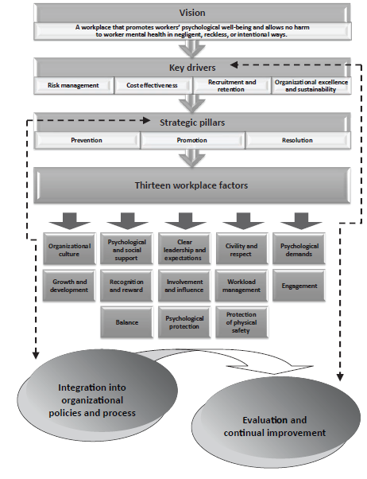
Implementation

Slide 17
Accommodation Plans
There are four simple steps in creating an accommodation plan:
Recognize the need
Gather the relevant information
Write an individual accommodation plan
Implement and Monitor the plan
Accommodation plans do not mean that performance management isn’t possible. Rather, it can help to support it.

Slide 18
Mental Health Accommodation's Suggestions
Flexible scheduling
Changes in supervision – information delivery
Changes in training – time and space
Modifying job duties – recognizing job description
Using technology – UV lamps
Modifying work space or changing location
Job coaching

Slide 19
Questions

