Slide 1



Discover Ability Network
Hiring People With Disabilities:
Discover the Opportunity for Your Business
https://discoverability.network

Slide 2

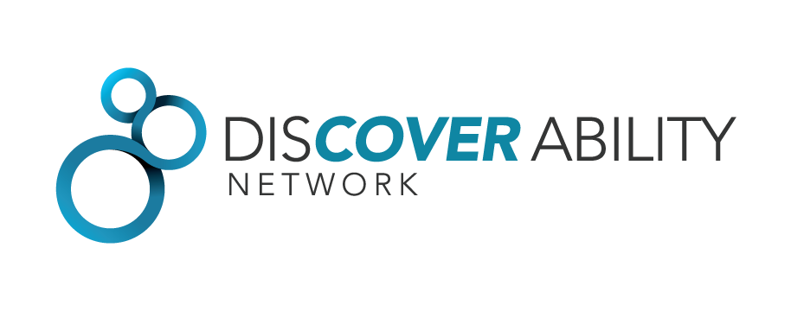

Untapped talent is costing Ontario
  Persons with disabilities represent a large untapped talent pool. Many are highly skilled, educated, and want to contribute to the economy.
  Many employers are aware of the benefits of diverse hiring, but do not know where to find qualified candidates who have a disability.
  The Discover Ability Network is here to connect them for free.

Slide 3
Why Care? Skilled Talent
  An Untapped Talent Pool
  77% of Ontario’s SMEs reported their number one challenge was finding talent.
  At the same time, people with disabilities represent an untapped talent pool that can help fuel innovative growth and a measured return on investment.
    50%
    of people with disabilities have high school diplomas
    40%
    of Ontarians with disabilities have some type of post-secondary credentials
    50,000
    students with disabilities in colleges and universities across Ontario
“
People with disabilities represent an almost untapped talent pool who bring a wide range of education, experience, expertise and perspective to the workforce.
-Forbes, July 30, 2015 (Business's Next Frontier: People With Disabilities)

Slide 4

Helping employers Hire and retain people with disabilities
Canadian Business Sense Ability has developed a step-by-step guide for employers to simplify and make-easy the recruitment process.
Employers will receive information on leading practices for hiring, retaining and integrating employees with disabilities into their workforce.
CALL TO ACTION is clear
Seize the opportunity, be bold and take a chance; the rewards to your business will be evident!

Slide 5

Discover Ability Roadmap
Ask the Person
Find Talent
Interview and hire
Onboard
Accommodations
Promote your success
Notes:
It is a pretty simple roadmap. Six easy steps, with tools in each section to help you get it right. The roadmap is designed in a modular fashion, so you can simply click on the step that you want to learn more about, or you can read through it sequentially.
A quick note on each step:
Step 1: Ask The Person (ATP). When in doubt, ask. While we may know someone with a disability, many of us feel uncomfortable that we don’t know about a specific disability or about asking questions to people with disabilities. First, remember that about 1 in 7 people have a disability, and that disability may be invisible. Chances are that you have more experience than you think. We want to welcome a wide range of people to apply to our company, or to be a customer. No one wants to say the wrong thing. If you do, simply apologize and move on.
Step 2: Find Talent. here are a lot of people with disabilities ready and willing to work. When you are ready to hire people with disabilities, you need to know where to look, let people with disabilities know that you welcome their applications, and make the process fair for everyone who applies. This includes job descriptions that list only the skills and experience that are truly needed for the job—a poorly written job description acts as a barrier to qualified candidates who can’t get past your screening criteria, but might be the perfect fit.
Step 3: Interview and Hire. You want to find the best person for the job. Relying on ‘gut feel’ or intuition may get us the candidate we like, or more often, someone who is like us. But ‘gut feel’ rarely leads to a person who is right for the job. You are looking for the best fit – the employee who can do the job and be happy in your workplace. That means selecting candidates based on their ability to do the job, not on how they look or on first impressions.
Step 4: Onboarding. Ask every potential employee whether they require accommodations during the recruitment process. If they need an accommodation, provide it. Document this. Ask all employees this question – it encourages everyone to be their best at work and is fair to everyone. There are tools are on the website for sample forms and processes.
Step 5: Accommodations. Hiring people costs money. Training employees’ costs even more money. Accommodations help you retain valuable talent and allow employees to do their jobs well. As an employer, you do not need to make the exact accommodation that your employee requests, but you do need to make a reasonable accommodation. Accommodating workers with disabilities may mean treating employees differently to be equitable. Fair does not always mean treating people the same.
Step 6: Promote Your Success. Focus on building an inclusive workplace culture to retain employees and attract job applicants. Keeping great talent is a big part of building a successful organization. Think about how you can build a culture where employees, and job applicants want to be part of your company. Share your success to attract the best and brightest.
Let’s take a look at the website now.

Slide 6

Step 1: Ask the Person
What to say?
What words to use?
Disability etiquette tips
Notes:
It is a pretty simple roadmap. Six easy steps, with tools in each section to help you get it right. The roadmap is designed in a modular fashion, so you can simply click on the step that you want to learn more about, or you can read through it sequentially.
A quick note on each step:
Step 1: Ask The Person (ATP). When in doubt, ask. While we may know someone with a disability, many of us feel uncomfortable that we don’t know about a specific disability or about asking questions to people with disabilities. First, remember that about 1 in 7 people have a disability, and that disability may be invisible. Chances are that you have more experience than you think. We want to welcome a wide range of people to apply to our company, or to be a customer. No one wants to say the wrong thing. If you do, simply apologize and move on.
Step 2: Find Talent. here are a lot of people with disabilities ready and willing to work. When you are ready to hire people with disabilities, you need to know where to look, let people with disabilities know that you welcome their applications, and make the process fair for everyone who applies. This includes job descriptions that list only the skills and experience that are truly needed for the job—a poorly written job description acts as a barrier to qualified candidates who can’t get past your screening criteria, but might be the perfect fit.
Step 3: Interview and Hire. You want to find the best person for the job. Relying on ‘gut feel’ or intuition may get us the candidate we like, or more often, someone who is like us. But ‘gut feel’ rarely leads to a person who is right for the job. You are looking for the best fit – the employee who can do the job and be happy in your workplace. That means selecting candidates based on their ability to do the job, not on how they look or on first impressions.
Step 4: Onboarding. Ask every potential employee whether they require accommodations during the recruitment process. If they need an accommodation, provide it. Document this. Ask all employees this question – it encourages everyone to be their best at work and is fair to everyone. There are tools are on the website for sample forms and processes.
Step 5: Accommodations. Hiring people costs money. Training employees’ costs even more money. Accommodations help you retain valuable talent and allow employees to do their jobs well. As an employer, you do not need to make the exact accommodation that your employee requests, but you do need to make a reasonable accommodation. Accommodating workers with disabilities may mean treating employees differently to be equitable. Fair does not always mean treating people the same.
Step 6: Promote Your Success. Focus on building an inclusive workplace culture to retain employees and attract job applicants. Keeping great talent is a big part of building a successful organization. Think about how you can build a culture where employees, and job applicants want to be part of your company. Share your success to attract the best and brightest.
Let’s take a look at the website now.

Slide 7

Step 2: Find Talent
Purple cows
Samples: Job analysis and task analysis
Where to look – Magnet Discover Ability
Service Agencies
Notes:
It is a pretty simple roadmap. Six easy steps, with tools in each section to help you get it right. The roadmap is designed in a modular fashion, so you can simply click on the step that you want to learn more about, or you can read through it sequentially.
A quick note on each step:
Step 1: Ask The Person (ATP). When in doubt, ask. While we may know someone with a disability, many of us feel uncomfortable that we don’t know about a specific disability or about asking questions to people with disabilities. First, remember that about 1 in 7 people have a disability, and that disability may be invisible. Chances are that you have more experience than you think. We want to welcome a wide range of people to apply to our company, or to be a customer. No one wants to say the wrong thing. If you do, simply apologize and move on.
Step 2: Find Talent. here are a lot of people with disabilities ready and willing to work. When you are ready to hire people with disabilities, you need to know where to look, let people with disabilities know that you welcome their applications, and make the process fair for everyone who applies. This includes job descriptions that list only the skills and experience that are truly needed for the job—a poorly written job description acts as a barrier to qualified candidates who can’t get past your screening criteria, but might be the perfect fit.
Step 3: Interview and Hire. You want to find the best person for the job. Relying on ‘gut feel’ or intuition may get us the candidate we like, or more often, someone who is like us. But ‘gut feel’ rarely leads to a person who is right for the job. You are looking for the best fit – the employee who can do the job and be happy in your workplace. That means selecting candidates based on their ability to do the job, not on how they look or on first impressions.
Step 4: Onboarding. Ask every potential employee whether they require accommodations during the recruitment process. If they need an accommodation, provide it. Document this. Ask all employees this question – it encourages everyone to be their best at work and is fair to everyone. There are tools are on the website for sample forms and processes.
Step 5: Accommodations. Hiring people costs money. Training employees’ costs even more money. Accommodations help you retain valuable talent and allow employees to do their jobs well. As an employer, you do not need to make the exact accommodation that your employee requests, but you do need to make a reasonable accommodation. Accommodating workers with disabilities may mean treating employees differently to be equitable. Fair does not always mean treating people the same.
Step 6: Promote Your Success. Focus on building an inclusive workplace culture to retain employees and attract job applicants. Keeping great talent is a big part of building a successful organization. Think about how you can build a culture where employees, and job applicants want to be part of your company. Share your success to attract the best and brightest.
Let’s take a look at the website now.

Slide 8

Step 3: Interview and Hire
The dangers of ‘gut feel’
Tools
  Plan an interview
  Conduct an interview
  Interview questions
Job Carving
Notes:
It is a pretty simple roadmap. Six easy steps, with tools in each section to help you get it right. The roadmap is designed in a modular fashion, so you can simply click on the step that you want to learn more about, or you can read through it sequentially.
A quick note on each step:
Step 1: Ask The Person (ATP). When in doubt, ask. While we may know someone with a disability, many of us feel uncomfortable that we don’t know about a specific disability or about asking questions to people with disabilities. First, remember that about 1 in 7 people have a disability, and that disability may be invisible. Chances are that you have more experience than you think. We want to welcome a wide range of people to apply to our company, or to be a customer. No one wants to say the wrong thing. If you do, simply apologize and move on.
Step 2: Find Talent. here are a lot of people with disabilities ready and willing to work. When you are ready to hire people with disabilities, you need to know where to look, let people with disabilities know that you welcome their applications, and make the process fair for everyone who applies. This includes job descriptions that list only the skills and experience that are truly needed for the job—a poorly written job description acts as a barrier to qualified candidates who can’t get past your screening criteria, but might be the perfect fit.
Step 3: Interview and Hire. You want to find the best person for the job. Relying on ‘gut feel’ or intuition may get us the candidate we like, or more often, someone who is like us. But ‘gut feel’ rarely leads to a person who is right for the job. You are looking for the best fit – the employee who can do the job and be happy in your workplace. That means selecting candidates based on their ability to do the job, not on how they look or on first impressions.
Step 4: Onboarding. Ask every potential employee whether they require accommodations during the recruitment process. If they need an accommodation, provide it. Document this. Ask all employees this question – it encourages everyone to be their best at work and is fair to everyone. There are tools are on the website for sample forms and processes.
Step 5: Accommodations. Hiring people costs money. Training employees’ costs even more money. Accommodations help you retain valuable talent and allow employees to do their jobs well. As an employer, you do not need to make the exact accommodation that your employee requests, but you do need to make a reasonable accommodation. Accommodating workers with disabilities may mean treating employees differently to be equitable. Fair does not always mean treating people the same.
Step 6: Promote Your Success. Focus on building an inclusive workplace culture to retain employees and attract job applicants. Keeping great talent is a big part of building a successful organization. Think about how you can build a culture where employees, and job applicants want to be part of your company. Share your success to attract the best and brightest.
Let’s take a look at the website now.

Slide 9

Step 4: onboarding
Sign up to Magnet
Tools
  Individual Accommodation Plans
  Employee Emergency Response Info
Notes:
It is a pretty simple roadmap. Six easy steps, with tools in each section to help you get it right. The roadmap is designed in a modular fashion, so you can simply click on the step that you want to learn more about, or you can read through it sequentially.
A quick note on each step:
Step 1: Ask The Person (ATP). When in doubt, ask. While we may know someone with a disability, many of us feel uncomfortable that we don’t know about a specific disability or about asking questions to people with disabilities. First, remember that about 1 in 7 people have a disability, and that disability may be invisible. Chances are that you have more experience than you think. We want to welcome a wide range of people to apply to our company, or to be a customer. No one wants to say the wrong thing. If you do, simply apologize and move on.
Step 2: Find Talent. here are a lot of people with disabilities ready and willing to work. When you are ready to hire people with disabilities, you need to know where to look, let people with disabilities know that you welcome their applications, and make the process fair for everyone who applies. This includes job descriptions that list only the skills and experience that are truly needed for the job—a poorly written job description acts as a barrier to qualified candidates who can’t get past your screening criteria, but might be the perfect fit.
Step 3: Interview and Hire. You want to find the best person for the job. Relying on ‘gut feel’ or intuition may get us the candidate we like, or more often, someone who is like us. But ‘gut feel’ rarely leads to a person who is right for the job. You are looking for the best fit – the employee who can do the job and be happy in your workplace. That means selecting candidates based on their ability to do the job, not on how they look or on first impressions.
Step 4: Onboarding. Ask every potential employee whether they require accommodations during the recruitment process. If they need an accommodation, provide it. Document this. Ask all employees this question – it encourages everyone to be their best at work and is fair to everyone. There are tools are on the website for sample forms and processes.
Step 5: Accommodations. Hiring people costs money. Training employees’ costs even more money. Accommodations help you retain valuable talent and allow employees to do their jobs well. As an employer, you do not need to make the exact accommodation that your employee requests, but you do need to make a reasonable accommodation. Accommodating workers with disabilities may mean treating employees differently to be equitable. Fair does not always mean treating people the same.
Step 6: Promote Your Success. Focus on building an inclusive workplace culture to retain employees and attract job applicants. Keeping great talent is a big part of building a successful organization. Think about how you can build a culture where employees, and job applicants want to be part of your company. Share your success to attract the best and brightest.
Let’s take a look at the website now.

Slide 10
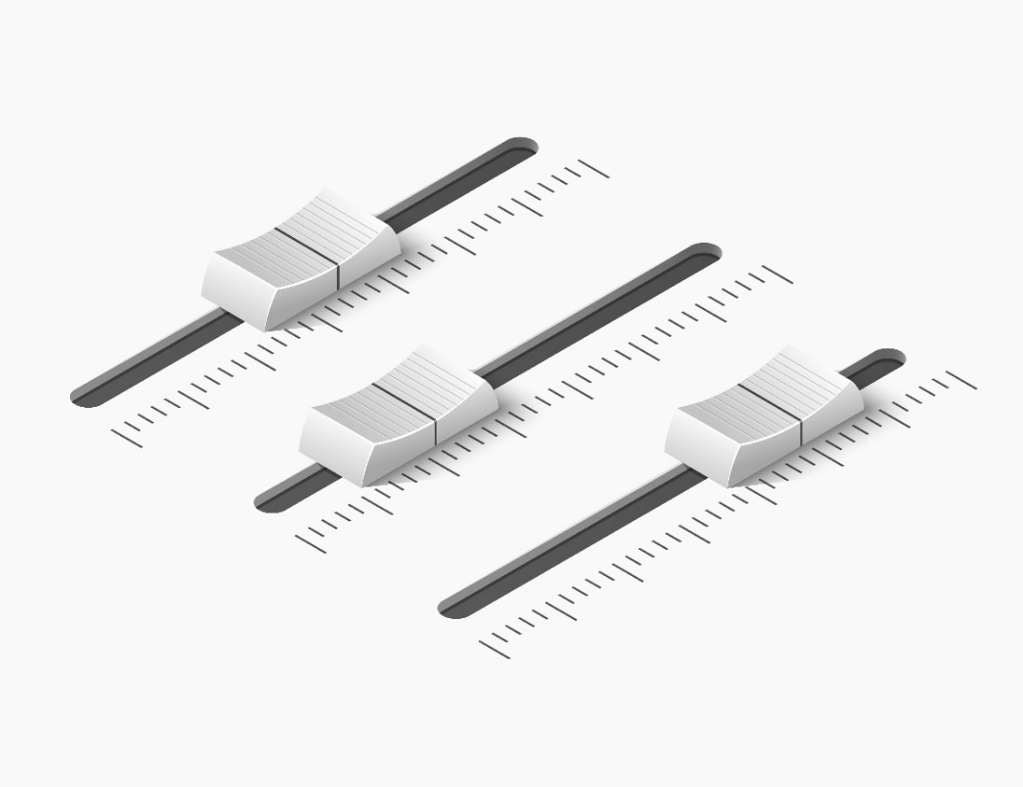
Step 5: Accommodations
What is an accommodation (with examples)
How to accommodate
The cost of accommodating
Assistive technologies examples
Notes:
It is a pretty simple roadmap. Six easy steps, with tools in each section to help you get it right. The roadmap is designed in a modular fashion, so you can simply click on the step that you want to learn more about, or you can read through it sequentially.
A quick note on each step:
Step 1: Ask The Person (ATP). When in doubt, ask. While we may know someone with a disability, many of us feel uncomfortable that we don’t know about a specific disability or about asking questions to people with disabilities. First, remember that about 1 in 7 people have a disability, and that disability may be invisible. Chances are that you have more experience than you think. We want to welcome a wide range of people to apply to our company, or to be a customer. No one wants to say the wrong thing. If you do, simply apologize and move on.
Step 2: Find Talent. here are a lot of people with disabilities ready and willing to work. When you are ready to hire people with disabilities, you need to know where to look, let people with disabilities know that you welcome their applications, and make the process fair for everyone who applies. This includes job descriptions that list only the skills and experience that are truly needed for the job—a poorly written job description acts as a barrier to qualified candidates who can’t get past your screening criteria, but might be the perfect fit.
Step 3: Interview and Hire. You want to find the best person for the job. Relying on ‘gut feel’ or intuition may get us the candidate we like, or more often, someone who is like us. But ‘gut feel’ rarely leads to a person who is right for the job. You are looking for the best fit – the employee who can do the job and be happy in your workplace. That means selecting candidates based on their ability to do the job, not on how they look or on first impressions.
Step 4: Onboarding. Ask every potential employee whether they require accommodations during the recruitment process. If they need an accommodation, provide it. Document this. Ask all employees this question – it encourages everyone to be their best at work and is fair to everyone. There are tools are on the website for sample forms and processes.
Step 5: Accommodations. Hiring people costs money. Training employees’ costs even more money. Accommodations help you retain valuable talent and allow employees to do their jobs well. As an employer, you do not need to make the exact accommodation that your employee requests, but you do need to make a reasonable accommodation. Accommodating workers with disabilities may mean treating employees differently to be equitable. Fair does not always mean treating people the same.
Step 6: Promote Your Success. Focus on building an inclusive workplace culture to retain employees and attract job applicants. Keeping great talent is a big part of building a successful organization. Think about how you can build a culture where employees, and job applicants want to be part of your company. Share your success to attract the best and brightest.
Let’s take a look at the website now.

Slide 11



Step 6: Promote your Success
Keeping great talent
Tool: Return to work procedure
How to accommodate
Celebrate inclusion
Notes:
It is a pretty simple roadmap. Six easy steps, with tools in each section to help you get it right. The roadmap is designed in a modular fashion, so you can simply click on the step that you want to learn more about, or you can read through it sequentially.
A quick note on each step:
Step 1: Ask The Person (ATP). When in doubt, ask. While we may know someone with a disability, many of us feel uncomfortable that we don’t know about a specific disability or about asking questions to people with disabilities. First, remember that about 1 in 7 people have a disability, and that disability may be invisible. Chances are that you have more experience than you think. We want to welcome a wide range of people to apply to our company, or to be a customer. No one wants to say the wrong thing. If you do, simply apologize and move on.
Step 2: Find Talent. here are a lot of people with disabilities ready and willing to work. When you are ready to hire people with disabilities, you need to know where to look, let people with disabilities know that you welcome their applications, and make the process fair for everyone who applies. This includes job descriptions that list only the skills and experience that are truly needed for the job—a poorly written job description acts as a barrier to qualified candidates who can’t get past your screening criteria, but might be the perfect fit.
Step 3: Interview and Hire. You want to find the best person for the job. Relying on ‘gut feel’ or intuition may get us the candidate we like, or more often, someone who is like us. But ‘gut feel’ rarely leads to a person who is right for the job. You are looking for the best fit – the employee who can do the job and be happy in your workplace. That means selecting candidates based on their ability to do the job, not on how they look or on first impressions.
Step 4: Onboarding. Ask every potential employee whether they require accommodations during the recruitment process. If they need an accommodation, provide it. Document this. Ask all employees this question – it encourages everyone to be their best at work and is fair to everyone. There are tools are on the website for sample forms and processes.
Step 5: Accommodations. Hiring people costs money. Training employees’ costs even more money. Accommodations help you retain valuable talent and allow employees to do their jobs well. As an employer, you do not need to make the exact accommodation that your employee requests, but you do need to make a reasonable accommodation. Accommodating workers with disabilities may mean treating employees differently to be equitable. Fair does not always mean treating people the same.
Step 6: Promote Your Success. Focus on building an inclusive workplace culture to retain employees and attract job applicants. Keeping great talent is a big part of building a successful organization. Think about how you can build a culture where employees, and job applicants want to be part of your company. Share your success to attract the best and brightest.
Let’s take a look at the website now.

Slide 12
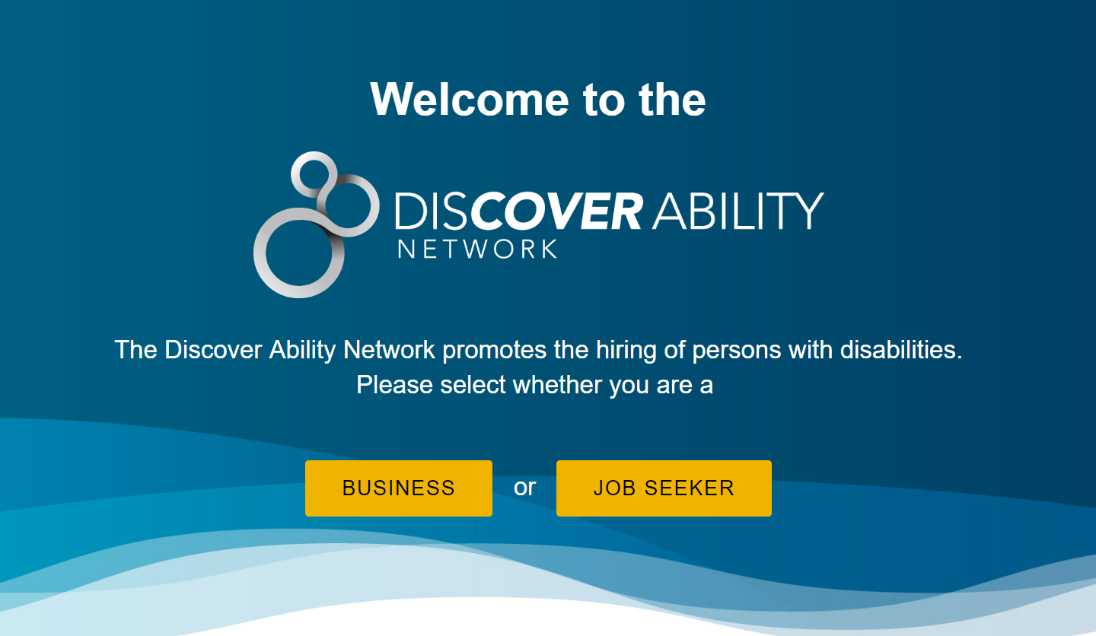


Slide 13



Some Key Features
DISCOVER ABILITY NETWORK
  The portal will feature dynamic content that will capture visitor interest and provide valuable information for employers.
Resources
Employers will be able to access HR resources, toolkits and industry reports to grow their ability in hiring people with disabilities.
Video Content
Promotional videos interviewing leading companies will drive home the business case and promote best practices in this space.
Social Media
Variety of social media to raise awareness of the portal and promote the business case with regular posts (i.e., 2-3 posts/week).

Slide 14
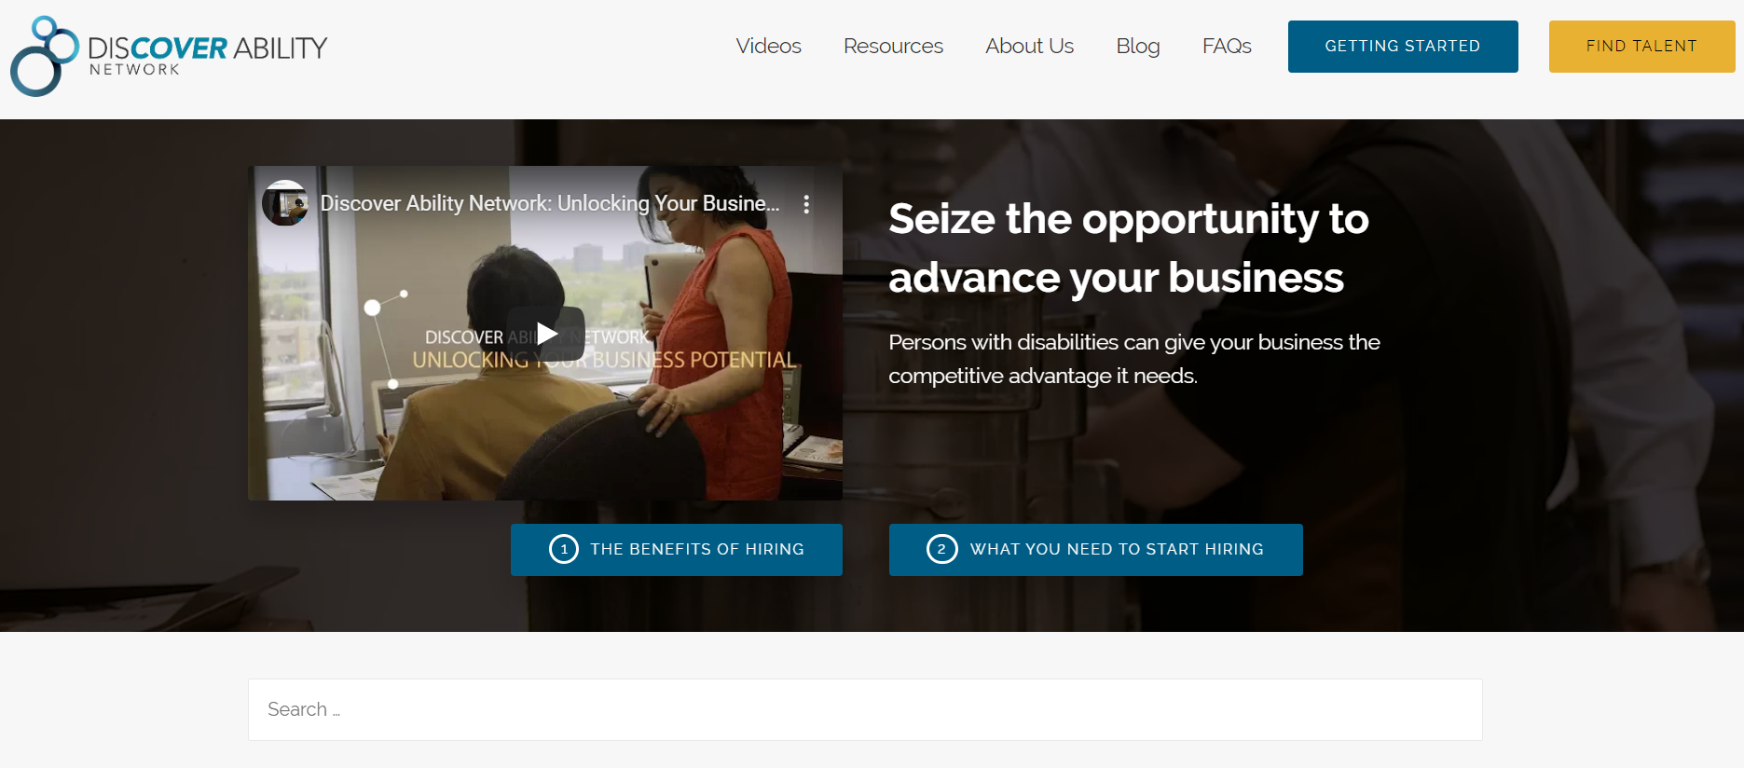

Https://discoverability.network

Slide 15
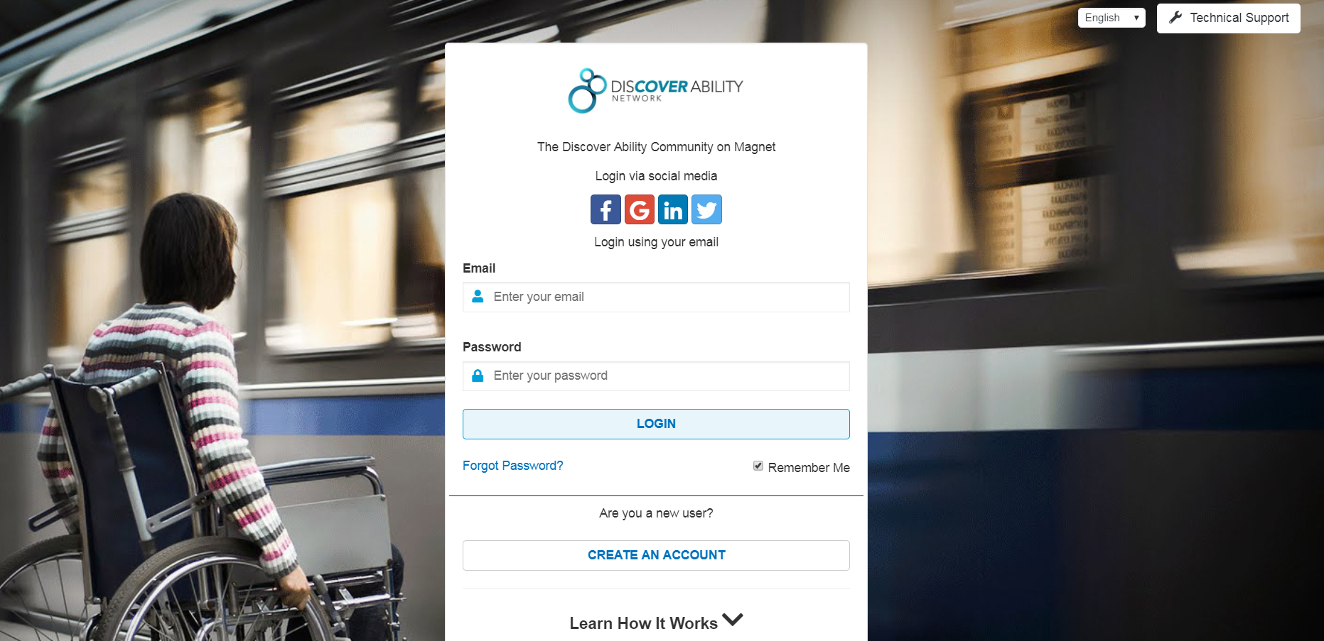
Find talent today

Slide 16
POWERED BY MAGNET
  Network powered by a job-matching technology
  Connects job seekers to employers based on skills, preferences and talent needs
  Launched in September 2014
  Brings together various stakeholder groups on one common platform to address one common goal, in this case persons with disabilities and employers

Slide 17

LEVERAGE DIVERSITY SETTINGS
v
  Create an employer profile
  Post your jobs
  Apply a diversity filter for persons with disabilities
  Connect to qualified candidates in real time who also happen to have a disability
  Magnet is a social initiative, making it completely free for employers to use

Slide 18

Discover Ability Network Talent Hubs
Ottawa
Windsor-Essex
London
Sault Ste. Marie
Halton-Peel
Hamilton
Lead Organization
Lead Organization
Lead Organization
Lead Organization
Lead Organization
Supporting Organizations
Supporting Organizations
Supporting Organizations
Supporting Organizations
Supporting Organizations
Opportunities
Data
Opportunities
Opportunities
Opportunities
Data
Opportunities
Data
Data
Data
Job Seekers
& Employers
Job Seekers
& Employers
Job Seekers
& Employers
Job Seekers
& Employers
Job Seekers
& Employers

Slide 19
CONTACT US
Discover Ability
discoverability@occ.ca
Louie DiPalma
louiedipalma@occ.ca
Jason Chang
jasonchang@occ.ca
Bojan Mitrovic
boyanmitrovic@occ.ca

