Slide 1
Promoting Employment for People with Disabilities
Sir Sanford Fleming College
October 23, 2019
Alf Spencer
Director, Public Education and Outreach
Ministry for Seniors and Accessibility

Slide 2
Building Bridges: Linking Employers to Postsecondary Graduates with Disabilities
Ontario Chamber of Commerce 2013 report
Three demand-side barriers:
Myths and misconceptions of employers about the constraints and costs of employing PWD
High opportunity costs of tapping into PWD labour pool, especially for small and medium-sized employers
Lack of information on how to recruit, accommodate and retain employees with disabilities
Three supply-side barriers:
Lack of work-related experience
Institutional barriers at postsecondary institutions
Absence of transitional support to employment after graduation
Notes:
The report identified 3 demand-side barriers:
Myths and misconceptions of employers about the constrains and costs of employing people with disabilities
High opportunity costs of tapping into labour pool of PWDs, especially among small and medium-sized employers
Absence of information on how to recruit, accommodate and retain employees with disabilities
The report focused on addressing demand-side barriers, but also identified three supply-side barriers:
Lack of work-related experience among postsecondary students and graduates with disabilities
Institutional barriers (gaps in info sharing between accessibility service and career service departments)
Absence of transitional support to employment after graduation

Slide 3
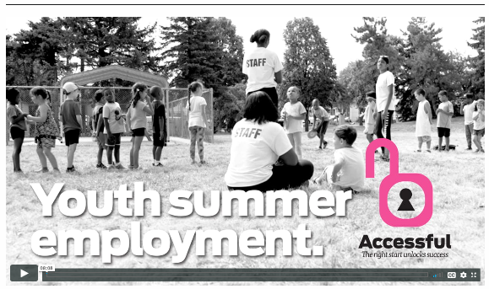
Project Accessful: Helping Youth With Disabilities Find Their First Summer Jobs
EnAbling Change Program 2018-19
Research indicates having one paid job in high school is the number one predictor of future employment for people with disabilities.
Project Accessful focussed on finding summer jobs for 50 high school students with disabilities from 15 schools in Peel Region.
The goal was to strengthen the students’ employability by developing résumé, interview and jobsite skills and providing summer job employment experiences.
The students and their parents developed hope and confidence about future employment while the employers learned a lot about the capabilities of people with disabilities.
Notes:
Research indicates having one paid job in high school is the number one predictor of future employment for people with disabilities. (Source: Hammill Institute on Disabilities, University of Wisconsin-Madison)

Slide 4
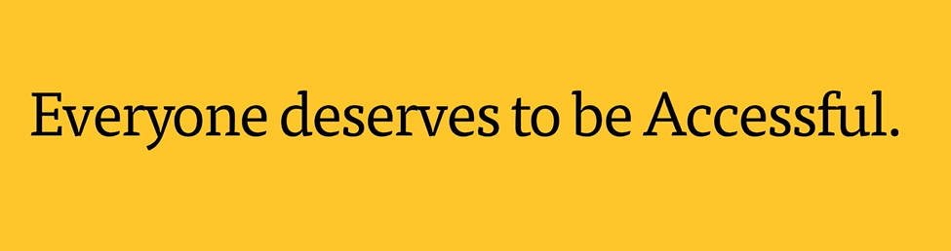
Project Accessful
The project surpassed its original target by 44% and matched 72 students to a wide variety of jobs:
Sales Assistant, Retail Cosmetics Store
Assistant, Cultural Centre & Community Library
General Laborer, Roofing Company
Carpenter’s Assistant, Home Construction Company
Repair Assistant, Video Gaming & Computer Store
Retail Assistant, Large Retailer
Helper, Day Care Business
Dog Sitter, Dog Walker, Self-Employed
Stable Worker, Equestrian Boarding Centre
Produce Dept., Large Discount Grocery Store
Warehouseman, Receiving/Shipping, International Courier Company
Custodial Duties, Cinema Chain
Assistant, Transport Truck/ Local Warehouse
Server, Large Restaurant Chain
Crew Members, Fast Food Chains
Cashier, Retail Bagel/Pretzel Bakery
Assistant, Local Catering/Food Service
Summer Staff, Parks & Recreation, Municipal & Regional Gov't

Slide 5
EnAbling Change Program 2019-20
Ontario Restaurant Hotel and Motel Association: Diversity Recruitment Program
The project will work collaboratively with industry stakeholders and operators to address labour shortages in the hospitality and tourism sector by increasing employment opportunities for job seekers with disabilities.
Through a Diversity Recruitment Specialist/Co-ordinator that will liaise with employment agency networks, a strategy will be developed to facilitate employment.
This project will help employers attract, hire and retain a diverse and inclusive workforce to meet current and emerging business needs in the hospitality sector.

Slide 6

EnAbling Change Program 2019-20
Retail Council of Canada: Inclusive Hiring for Retailers
The project will support the accessible recruitment and retention, which includes hiring people with disabilities and promoting the removal of attitudinal barriers within the workplace.
Through a series of webinars, they will discuss:
  How to meet Ontario’s accessible employment standards
  how to adapt the hiring process to meet the needs of people with various types of disabilities
  mental health disabilities and how to remove the associated stigma in stores for both employees and customers

