Slide 1
Your First Stop for Employment
370 Kent Street West
Lindsay, Ontario
K9V 6G8
705.328.0180
vccs.work

Slide 2
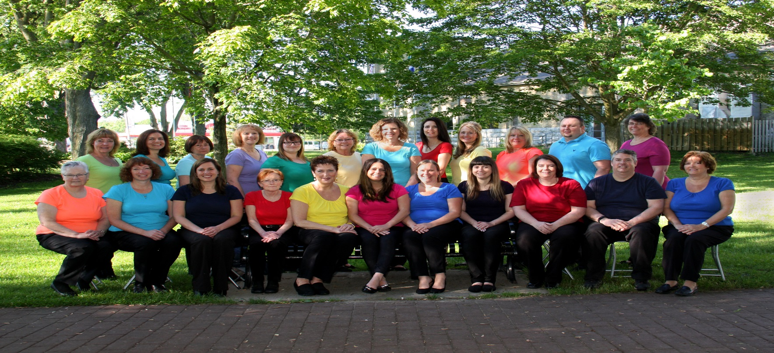
Who Are We?
A non-profit organization Funded by the Ministry of Training Universities & Colleges, Service Canada & the United Way
Governed by a volunteer Board of Directors
24 staff
10 mentors

Slide 3
Our Clients
Job seekers age 16 and up
Individuals with Disabilities
Individuals who are at Risk
Individuals who need help to access the job market

Slide 4
Our Services
Employment Counselling
Guidance & support to find a job
Assistance with resumes, cover letters & interview preparation
Assessment of your current skills & exploration of retraining options
Career planning & skill enhancement

Slide 5
Resources & Information
Resource & Information
A fully equipped & accessible resource room
Current Information & Resources to support job search
Community resources and referrals

Slide 6
Job Matching & Placement
Job Development & Placement
Access to local employment
On the job individualized training
Job trials and paid work placements
Advocacy and support on the job

Slide 7
Accessibility in our Workplace
Current accessibility policy for the agency its clients and staff
Workspace is 1 floor located at ground level
All bathrooms, entrances, offices and hallways are accessible
Use of technology to assist and accommodate Sight and Hearing impaired
Staff training and feedback process

Slide 8
Working to Make it WORK!
Working directly with individuals to meet their needs in
the workplace
Assessment of workplace environments and accommodation within the workspace
Individualized training plans unique to client needs
Funding to incent and support employers
Funding to support clients with disabilities
Advocacy, and support of individuals on the job
Community partnerships to provide additional support and expertise to individuals

Slide 9
Community Partners
Canadian Hearing Society
Canadian National Institute for the Blind
Ontario Works
John Howard
Literacy Ontario
Ontario Disability Support Program
Sir Sandford Fleming College
Job Quest
City of Kawartha Lakes

Slide 10
Contact Us:
370 Kent Street West
Lindsay, Ontario K9V 6G8
705-328-0180
vccs.work

