Slide 1
Ken Van Den Oetelaar
91.9 BOB FM (CKLY-FM)
Notes:
Introduction

Slide 2
About Me
Lindsay resident for 36 years
Attended Central Senior School / I.E. Weldon SS.
Worked jobs in the retail / Restaurant industry.
Started with CKLY in 2004 as a part time IT Tech.
Moved to full time in production / IT in 2008.
Have had accommodations done to the production office to make it so I can do my job with my visual disability.
Notes:
I have lived in Lindsay for most of my life, I have attended middle and high school here. I have work in the retail and the restaurant field before I ended up where I am today.
I started with CKLY in 2004 as a part time IT Tech. In 2008 I moved into production full time. To have this move happen we had to have some accommodations taken care of for me to be able to do the job effectively.

Slide 3
Who helped
VCCS
Helped CKLY with the cost of hiring a new fulltime employee.
CNIB
Helped CKLY understand the workplace accommodations needed for a person with Visual disabilities.
Helped acquire a Digital Magnifier.
Notes:
We had VCCS and the CNIB involved in helping CKLY understand the types of accommodation that would be needed for me.
The CNIB helped with acquiring a digital magnifier. And recommended the type of lights that would best accommodate me in the room. CKLY decided to change the lights out from small track lights to 2 2 bulb fluorescents right above my work area.
VCCS helped CKLY with the costs of hiring a new fulltime employee.

Slide 4
What are my duties
Daily maintenance of IT systems.
Production of IDs, Commercials, Daily contest audio.
Daily music scheduling
Help other staff with any IT issues that may arise thru the day.
On call 24 / 7 for any power / IT / Transmission problems.
Help / cover Peterborough Engineering.
Ensure the smooth and continued operation of automation systems.
Setup of all broadcasts outside of the building. i.e. Kinsmen Toy Drive
Notes:
So now that I have been employed at CKLY for the past 10 years as a fulltime employee, My duties have evolved thru out those years.
I still do IT for the building. I deal with everything from everyday user problems to automation and server issues and maintenance.
I now schedule music on a daily basis, Produce and upload commercials, station IDs, promos, Contest imaging.
I work in hand with our Peterborough engineer and we cover each other when we take holidays.
I also take care of any remote broadcast setup and tear downs. Like our Kinsmen toy drive that is in Dec and we broadcast from Canadian Tire live for the day.

Slide 5
My Office
Better / Brighter Lighting
Larger Screen (27 inch on a monitor arm)
Notes:
Here is a look at my office.
My main monitor is a 27 inch Dell running on a windows 10 OS.
You can see this room is pretty bright now.

Slide 6
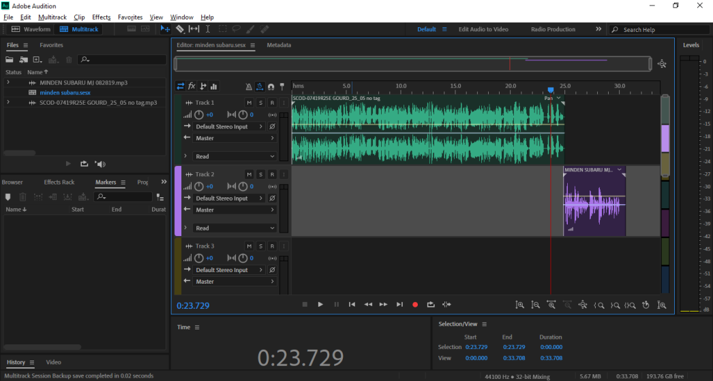
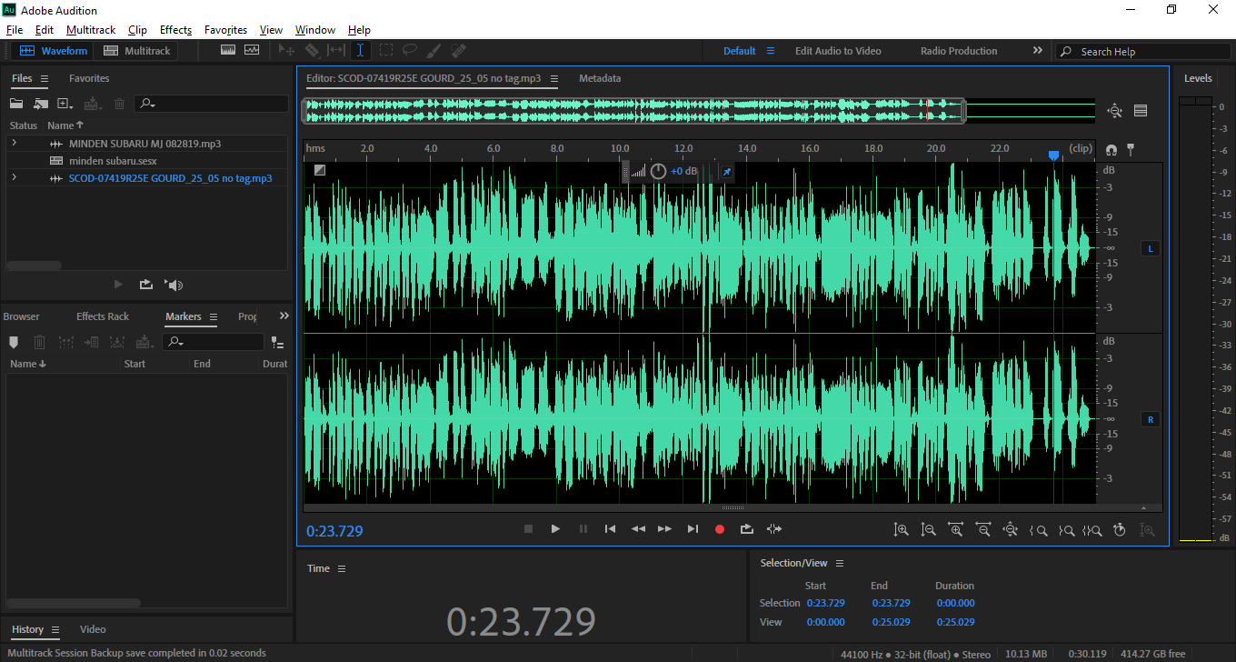
Production
Producing a Minden Subaru ad.
Adding a local voice tag to a national ad to air the next day.
Notes:
This here is an example of the program that I use to record and create commercials, ID, promos.

Slide 7
My Other Office
All machines in the rack room are accessible from my office via remote desktop so I can manage them on my larger 27 inch screen.
Notes:
This is my other office.
I take care of 3 servers and 9 PCs in this rack room.
As you can see it is pretty bright in here too.

Slide 8
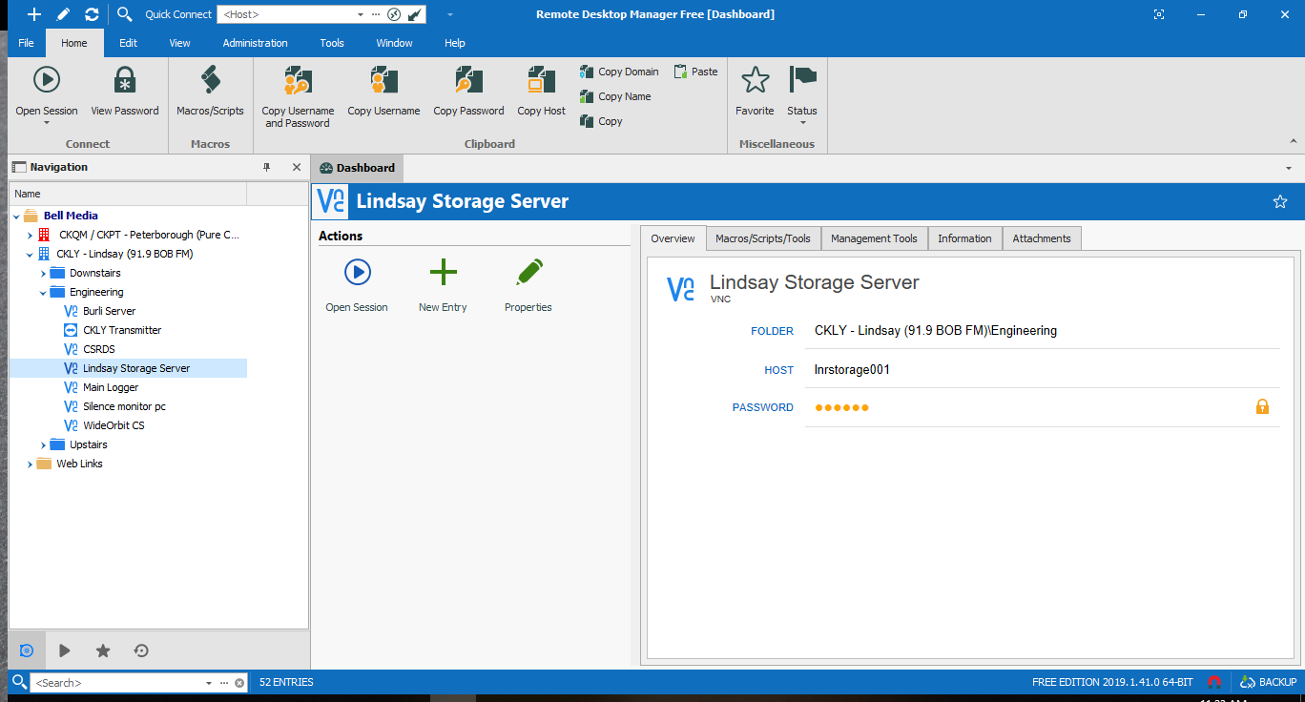
IT Duties
Manage and maintain server and workstations in both Lindsay and Peterborough offices
Notes:
This is an example of the software that I use to remotely control all of the systems in the rack room and the user PCs in the station. And at our Peterborough stations.
I am also able to remote into both Lindsay and Peterborough stations from home to help fix issues that may come up.

Slide 9
CKLY Control Room
In this room I am required to take care of any maintenance / tech issues that may arise from day to day.
Notes:
This is the control room, Where Dave and Julie broadcast from every morning. I also maintain the console and computers in here.

Slide 10
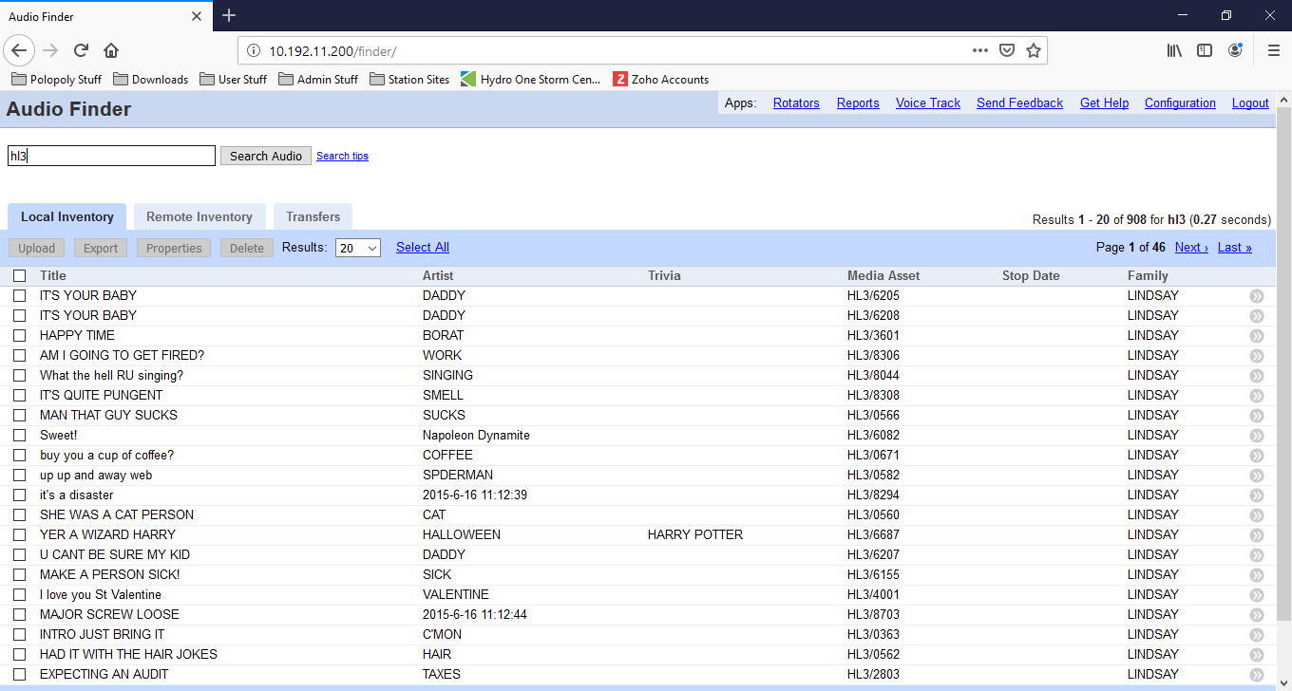
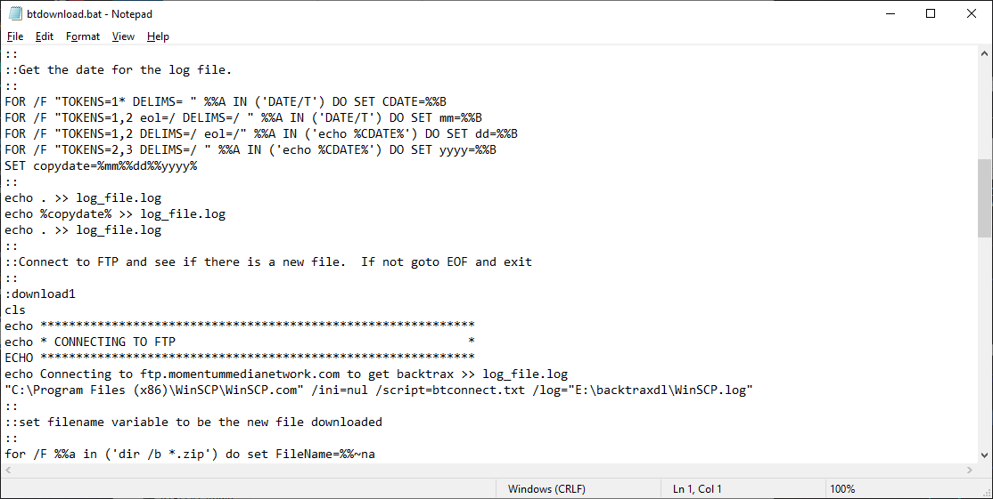
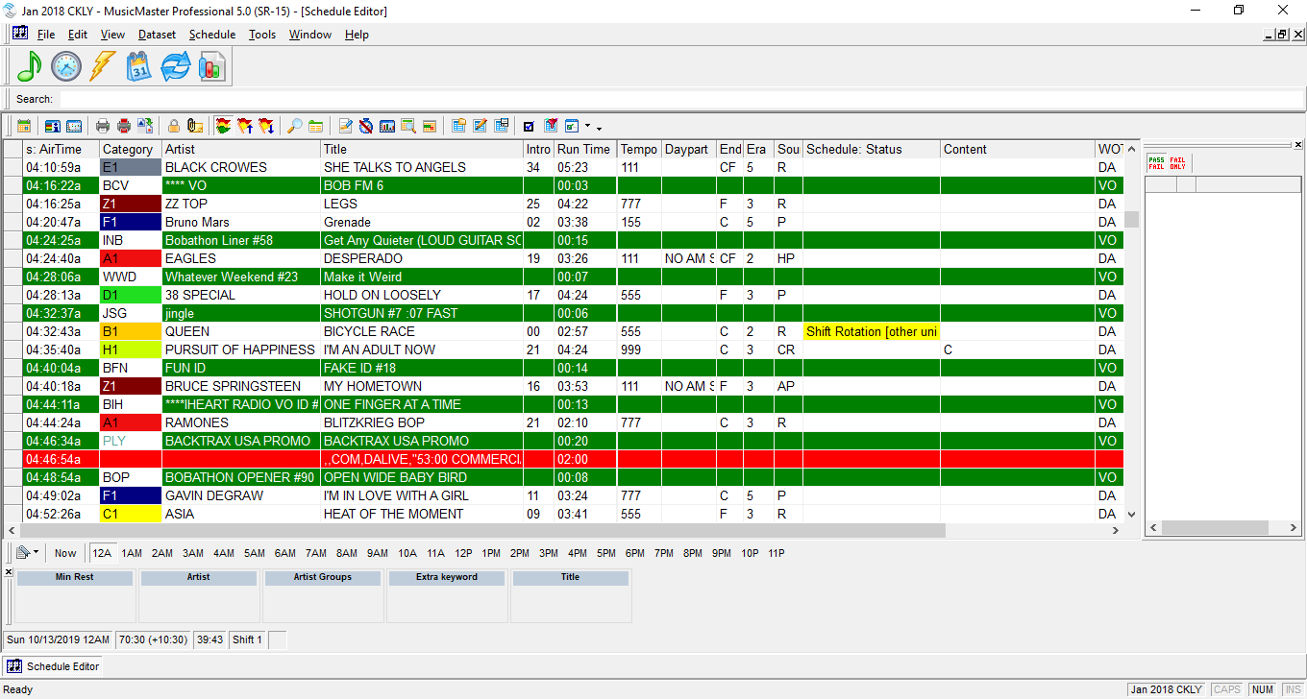
Music Programming / Automation Systems
Create scripts to automate the ingest of weekly shows . Also delete / add songs / commercials on a daily basis to the automation systems for both Lindsay and Peterborough stations
Notes:
This is part of our music scheduling program and automation systems.
I have created some scripts to automatically ingest shows that we play over the weekends.
With some of the systems here I would need to be about 2 to 4 inches away from the screens to read what is in it because of the different resolutions that each user may use. I use to have to have the user read to me what the screen said and help them out that way sometimes. BUT. A few year ago I found out about this product called ORCAM MyEye. I now use it everyday at work.

Slide 11
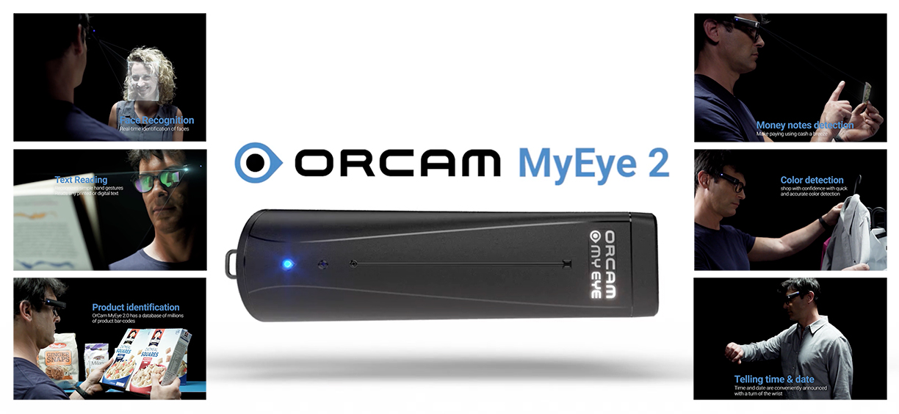
The most advanced wearable assistive technology device for the blind and visually impaired, that reads text, recognizes faces, identifies products and more.
Notes:
This little device that attached to my glasses.

Slide 12
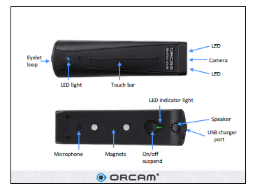
MyEye 2.0
Notes:
is light enough that I can keep it attached to my glasses all day long.
It keeps a charge for most of the day. There have been time I have had to recharge it thru the day.
To use it is as simple as pointing.
It has helped me pretty much everyday in my job.

Slide 13
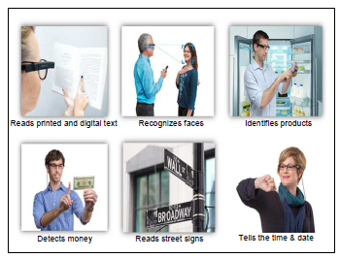
MyEye 2.0
Read Text
Including: newspapers, books, menus, signs, product labels and screens.
Recognize Faces
Real time identification of faces is seamlessly announced.
Identify Products
Identification of products, enabling an independent shopping experience.
Easy-to-Use
Intuitively responds to simple hand gestures.
Portable
Small, lightweight, and magnetically mounts onto virtually any eyeglass frame.
Works Everywhere
Tiny, wireless, and does not require an internet connection.
Notes:
It will read text aloud.
Does facial recognition
Product identification
And money and colour recognition.

Slide 14
Thank You!

