Slide 1
UNIVERSAL DESIGN FOR LEARNING (UDL)
Laura Gibson
Learning Strategist, Fleming College
Wednesday, October 23, 2019

Slide 2
What is UDL?
A theory?
A movement?
A set of guidelines?
A mindset?
Goal for session:
To understand UDL as a mindset.
A mindset whereby we acknowledge the vast variability of our learners of today and most importantly, consider this in the design and planning process from the start!

Slide 3
What is UDL?
Pre-video exercise:
What do you think UDL might look like in a postsecondary education setting?
A brief video developed by CAST about using Universal Design in a College Setting:
https://www.youtube.com/watch?v=U1B6yQXsr0c
Post-video exercise:
Any surprises? Is it what you thought it was? Any take-away messages?
In what ways are you already using UDL in your workplaces?

Slide 4
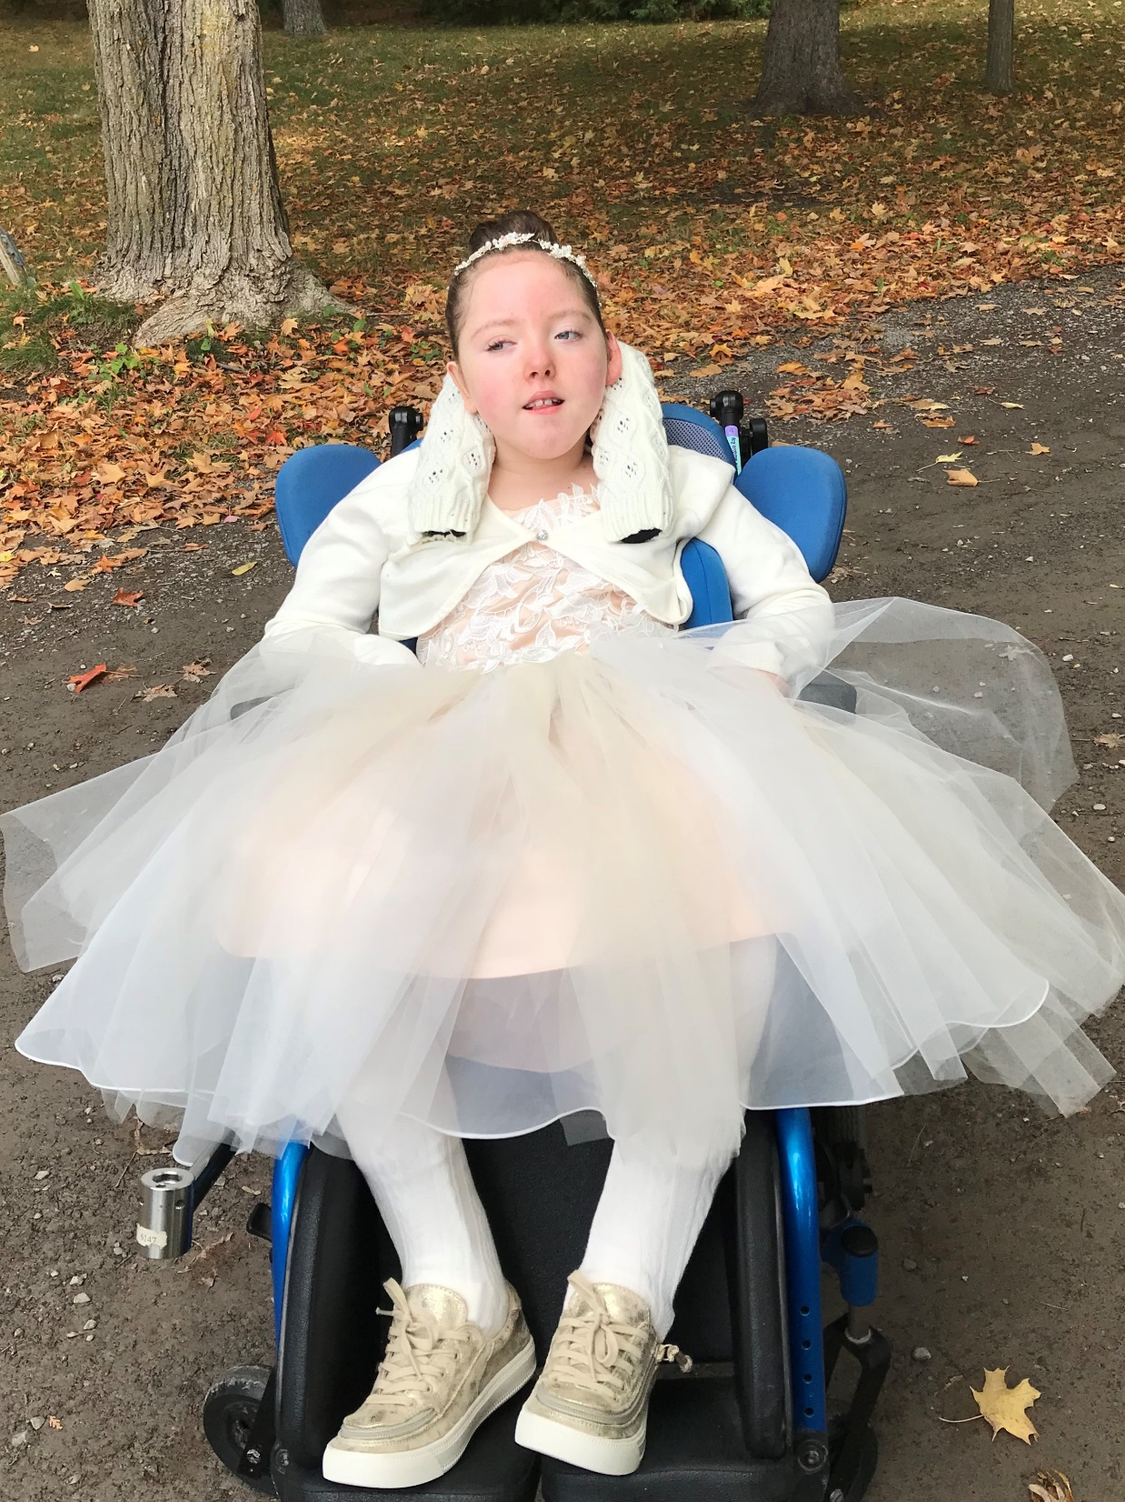
Meet Katie!
A pure example of how planning with inclusion and accessibility from the start can pay off – for Katie and for everyone!

Slide 5
Katie’s first home.

Slide 6
Ideas to modify raised ranch home to make it accessible:
Porch lift to rear deck granting access to main floor through garden doors
Internal elevator, telecab or platform stair lift with ramped access to bottom level through side door
Ultimately access could be gained but major renovation to internal areas
Not a financially responsible investment

Slide 7
Katie’s forever home!

Slide 8
Designed with a mindset of inclusion and accessibility from the start!
Slab on grade construction
Open concept
Attached garage
Low threshold doors
Wide hallways
Lever door handles
Low set windows
Roll in shower
Ceiling track lift

Slide 9
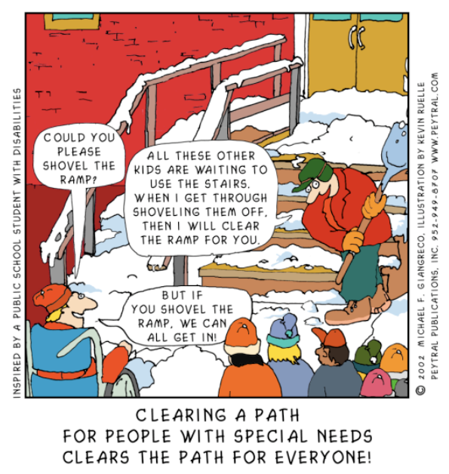

Slide 10
Thank you!

