Slide 1
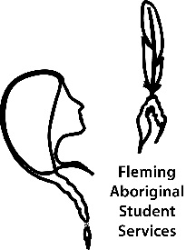
Fleming College is pleased to announce that… AN INDIGENOUS EDUCATION PROTOCOL SIGNING CEREMONY Will take place on: Monday December 07, 2015 | 11h00 | Sutherland Campus, 599 Brealey Drive, Peterborough Refreshments will be served | Please arrive 15 minutes early to secure parking in our visitor parking lot
Fleming College recognizes and affirms our responsibility for Indigenous education by adopting the seven principles of the Indigenous Education Protocol for Colleges and Institutes Canada (CICan)
COME CELEBRATE WITH US!
For more event information: Robin Broomfield | 866-353-6464, ext. 1281 | Robin.Broomfield@flemingcollege.ca

Slide 2
These seven principles will guide the institutions who agree to sign on to the Indigenous Education Protocol. Signatory institutions agree to:
1. Commit to making Indigenous education a priority.
2. Ensure governance structures recognize and respect Indigenous peoples.
3. Implement intellectual and cultural traditions of Indigenous peoples through curriculum and learning approaches relevant to learners and communities.
4. Support students and employees to increase understanding and reciprocity among Indigenous and non-Indigenous peoples.
5. Commit to increasing the number of Indigenous employees with ongoing appointments throughout the institution, including Indigenous senior administrators.
6. Establish Indigenous-centred holistic services and learning environments for learner success.
7. Build relationships and be accountable to Indigenous communities in support of self-determination through education, training and applied research.

