Slide 1
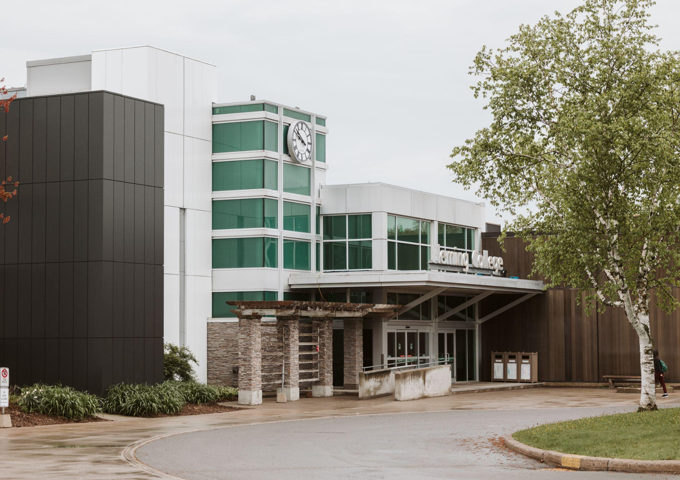

Student Ancillary Fees
November 2025
Notes:
You can swap out the background image to match your home campus

Slide 2
Our Topics
1
4
2
5
3
6
What are ancillary fees?​
Roles
What are Fleming’s ancillary fees?​
Process & Timelines​
Ancillary Fee Protocols
Questions​

Slide 3
Attending Fleming College is more than just going to class.
Ancillary Fees​
​
All students are charged ancillary fees in addition to your tuition; these fees are approved by your Student Government and the Board of Governors. Ancillary fees provide resources and services that are important in supporting you as a student, these can be different between our campuses. Fees charged to support services and activities distinct from academic programming or general overhead for the institution. Examples of ancillary fees include convocation fees, student activity fees, athletic fees, health care and insurance fees, field trip fees and fees associated with the cost of buildings such as student centres. ​
Compulsory Ancillary Fees​
​
Ancillary fees that a student is required to pay in order to enroll in or successfully complete any course or program of instruction. There are two types of compulsory ancillary fees: ​
​
a. Program ancillary fees which are compulsory for students in applicable programs​
b. Institutional ancillary fees which are compulsory for all students. The protocol agreement applies to institutional ancillary fees which are compulsory for all students.​

Slide 4
Fleming Ancillary Fees
Alumni Fee
Student Achievement & Records
Information Technology Fee
Health & Counselling
Career Services
Academic Supports
One Card

Slide 5
ANCILLARY FEE PROTOCOLS
Ancillary Fee Protocol Agreement ​
Athletics Fee Protocol Agreement​
  developed by and agreed to by FSA, SAC, College reps​
  approved by Fleming’s Board of Governors​
  outlines our process for reviewing and changing fees​

Slide 6
Role of FSA/SAC
FSA/SAC will meet with the college annually to discuss potential fee increases.​
Upon receipt of the proposed fees from the College, FSA/SAC will discuss the fees at a regularly scheduled board meeting and consult with students as needed​
FSA/SAC have final approval of all compulsory ancillary fees and the Athletics Fee; approved changes to the College’s compulsory ancillary fees will be supported by SAC/FSA Board of Directors through a Board motion

Slide 7
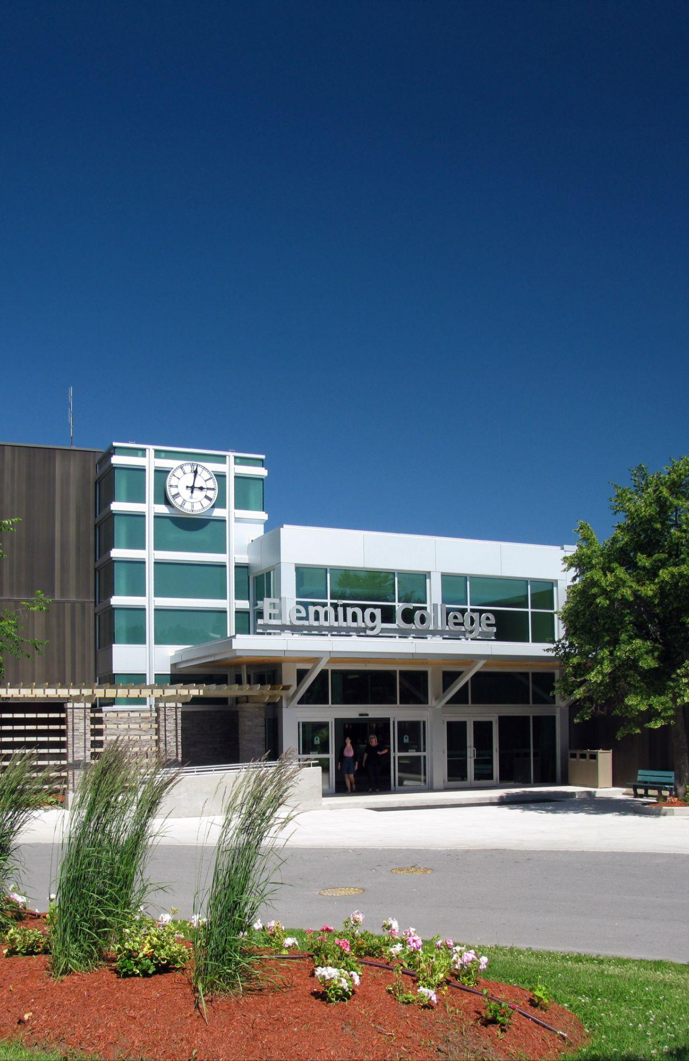
Questions?

