Slide 1
Lean Steering Committee Sept 2015
Notes:
Present:
Mark Morden, Brian Baker, Brian Bates, Kathy Hokum, Sue Kloosterman, George MacDougall, Sonia Crook, Thom Luloff, Trudy Heffernan, Lynn Watson, Trish O’Connor
Partial:
Krist Kerford, Robin Broomfield

Slide 2
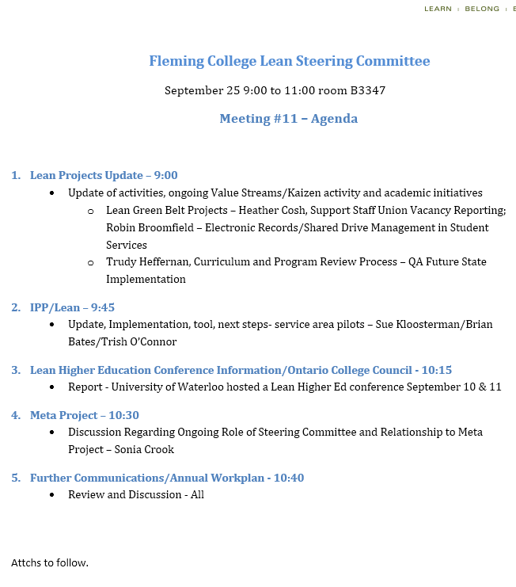
Agenda
Notes:
Trish Provided a quick overview of the annual report (link is on the affinity page for Lean)

Slide 3
Greenbelt Project Presentations
Lean Presentations - Sept 25 mtg.pptx
Notes:
Projects presented
– Trudy outlined the new QA process, note made regarding metrics gathered for Curriculum Renewal % of completion, %KPI analysis, % of Acton items and % actionable
- Robin’s project in Student Services can be replicated in other departments for electronic file management and greater efficiency in reduced time on task in locating and managing files/email (significant organizational issues)
-Heather Cosh’s reporting (Union Vacancy) project – it was noted by Kathy that the new process is a considerable improvement in timeliness and accuracy

Slide 4
Where we are today
Created draft IP policy
Rolled out “IPP Tool v1.0” and it is being effectively used
Now focusing on IP in Student Services area & IT Help Desk
Completed several Lean projects in the academic and service areas and currently building more capacity
Implemented gated process for PD with strong ties to IP
Inclusion of Integrated Planning thinking within Strategic Plan Development
Created Integrated college-wide committees including Complement, Budget, Capital and Space
Notes:
Updated on IPP – tool should be updated by end of the day
IP for Service – currently completing the first two pilots – Career and IT Help desk –shared framework (high level) next steps is to develop the template with ranking system

Slide 5
WLU
Notes:
Referenced other institutional frameworks for Integrated Planning

Slide 6
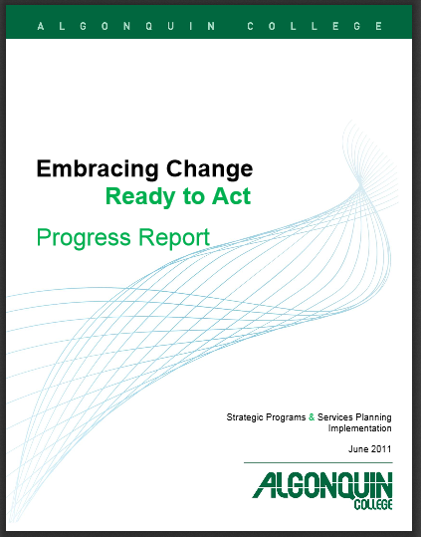
Algonquin Approach
Criteria (1-5 rating scale):
Relevance
Demand
Quality
Resource Utilization
Opportunities
Categories of Recommendations:
Enhance or Expand
Enhance/Modify
Maintain
Revise (programs)
Revise (Services)
Phase Out
Phase out with Transition to New Opportunity
Notes:
Referenced other institutional frameworks for Integrated Planning – Algonquin’s framework is comprehensive, however, likely not sustainable in terms of volume of work

Slide 7
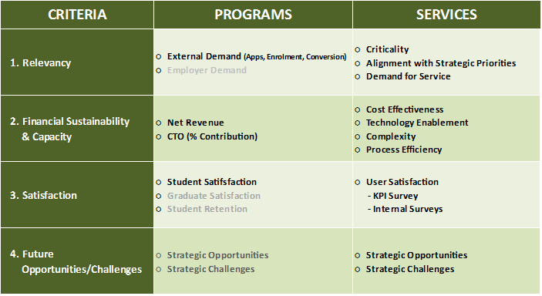
Niagara College
Notes:
Niagara’s framework for integrated planning

Slide 8
Fleming
Approach
Notes:
Fleming’s initial framework (high level brainstorming)

Slide 9
Next Steps
Continued to collect research from other institutions
Identified what metrics we have
Identified what metrics are relevant
Established steering committee
Piloting in 2 Services Area (looking at Career Services and IT)
Timeline – June Meeting with Student Services
Prototype tool by Winter 2016
Notes:
Timelines are on track – Trish has held workshops with career services and starts with IT help desk next week. Draft framework for career services shared at the meeting.

Slide 10
Questions for Career Services
What do we do?
Who needs it? How many need it?
How well do we do it? How do we know?
How efficiently do we do it?
How could we improve? How could we innovate or make better us of technology?
Notes:
Questions used to engage Career Services – worked well and is helping to get people thinking about assessment.

Slide 11
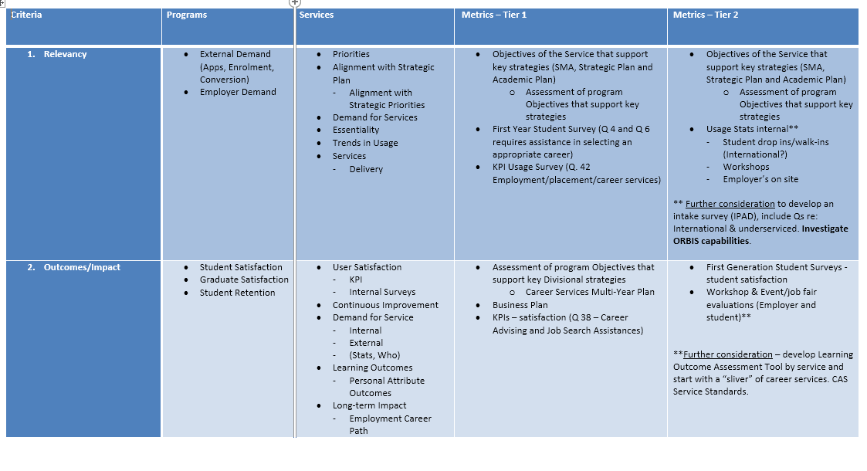
IP for Service Framework

Slide 12
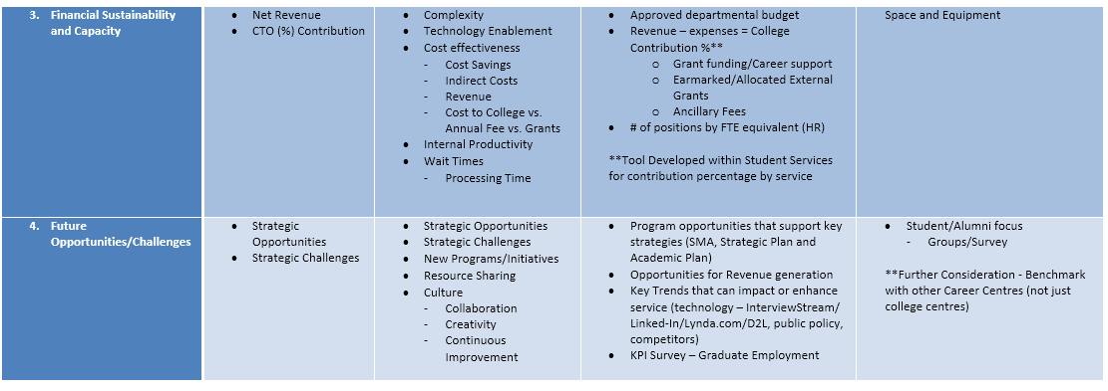
IP for Service Framework

Slide 13
Lean Conference – University of Waterloo
https://uwaterloo.ca/lean-conference/
Notes:
Trish provided highlight of conference – 8 Ontario Colleges present, Niagara, George Brown, Sheridan, Georgian, St. Lawrence, Sault, Algonquin and Fleming. All have agreed to continue with a Ontario College council for Lean to share best practices. Trish to distribute notes from the conference (done ).

Slide 14
Meta Project/Action Plan/Tracking Sheet
..\..\..\General\Action Plan\Lean Plan 2015-16 - DRAFT for Discussion.docx
..\..\..\General\Action Plan\Copy of Copy of 2015-16 Lean Action Plan Tracking - edited (2).xlsx
Notes:
Trish went through the Lean Action Plan at a high level (tracking sheet link here). Sonia provided an overview of the Meta Project. It was communicated that the Lean Steering Committee would now fold into the Meta Project which has an advisory committee structure. All of the planned and current Lean projects would be reported through the Meta project structure.

