Slide 1
urn It In @ Fleming
Deborah Leal & Mary Overholt
Learning Design & Support Team

Slide 2
Agenda
Attendee Intros (Name/Program)
Introduction to Turn it In
Benefits
Best Practices
Usage Considerations
Policy
Interface Overview

Slide 3
Introduction
Turn It In is an Internet-based text matching software that scans submitted work and compares it to public websites, journals and assignments submitted to Turn It In.
After scanning, sections of a submission are identified in an Similarity report.
The software will show students where plagiarism concerns exist and will make recommendations to correct it.
Turn It In is a proactive tool to address student academic integrity and not simply for imposing penalties.
Turn It In will be integrated with your D2L dropbox and will allow students to assess their citations within draft documents prior to final submission.

Slide 4
Benefits of Turn It In
Student opportunity to make corrections before final submission, without fear of punitive action
Similarity Reports can help students in locating additional sources
Deters students who may be considering cheating/plagiarising
Increases awareness of academic integrity, and demonstrates its importance and seriousness.
Allows instructor to respond to the needs of the students early, if used to provide instructor feedback on draft versions of assignments
Provides opportunities for the student to revise and improve work products and deepen understandings of using feedback to revise work

Slide 5
Best Practices
https://www.coursera.org/lecture/getinmooc/panel-discussion-part-2-avoiding-plagiarism-5LbS0

Slide 6
Best Practices (cont.)
Use anonymized Similarity Reports to prompt in-class discussion, or for tutorials around academic writing and plagiarism
Encourage students to use their Similarity Reports to examine text in their work identified as coming from another source, and review how that section of text has been referenced.
Develop an awareness in students that the Turn It In will only match against online sources, and that they need to ensure information from printed sources need to be referenced similarly
Use Similarity Reports to identify at-risk students and provide remedial action by inviting individual students to discuss their work and provide guidance with no punitive action taken as a result.
Ensure your students have sufficient time to receive and act upon their Turn It In feedback, as Similarity Reports may take up to 24 hours to generate during busy times.

Slide 7
Usage Considerations
Must factor in opportunities for students to submit drafts, receive the feedback, and act on that feedback
Students can opt-out. Provide backup options for assessment:
submitting multiple drafts to instructor
submitting associated annotated bibliography
providing copes of source documents

Slide 8
Usage Considerations (cont.)
Restrictions around upload size and content:
File must be less than 40 MB
Files must have at least 20 words of text
The maximum paper length is 400 pages
File types: HTML, Microsoft Word, Hangul Word Processor, OpenOffice Text, Rich text format, WordPerfect® (.wpd), Plain text (.txt) PostScript (.ps)

Slide 9
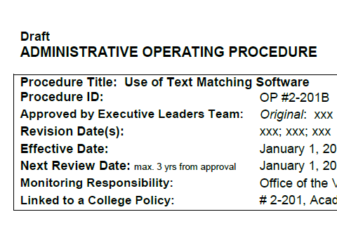
Policy
Course teams must take a consistent approach to use (one section = all sections)
Students must be informed of the use of Turn It In, integrity policies, and citation expectations, at course start
Course outline must include verbiage provided by Turn It In (#3)
Deciding on whether plagiarism has occurred is up to faculty, with Turn It In as a tool to aid in this decision
24 hour turnaround time to receive similarity report
Academic Integrity process when plagiarism is confirmed

Slide 10
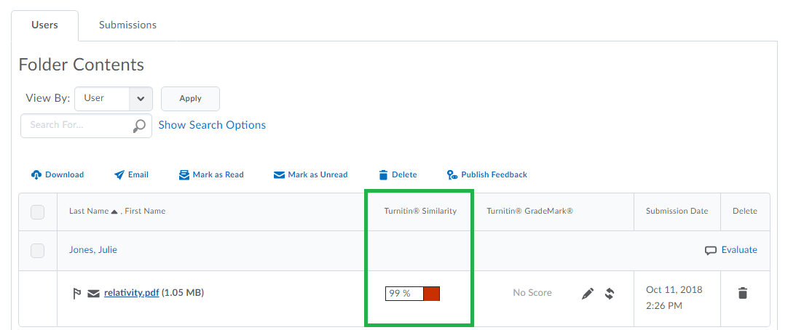
Interface Overview
Assessment > Dropbox > List of Assignment Dropboxes
Find assignment dropbox
Downward arrow > View Submissions (on given dropbox)

Slide 11
Interface Overview
https://www.youtube.com/watch?v=Grs3-JBf5G4

Slide 12
More information on Turn It In is available on the LDSTeam website, under the “Learning Technology” menu
Questions?

