Slide 1
Fleming Safe App Screening Tool

Slide 2
Home Screen
Two separate options related to COVID-19
COVID-19 Screening
Click link to begin your self-screening
COVID-19 Resources
Click link to find other COVID-19 resources

Slide 3
COVID-19 Screening
Self-Screening
Click "Start self-screening" to proceed to next page, to answer screening questions.
COVID –19 Badge
This section will show your badge and will indicate whether you have passed the self-screening process.
More Information
Links to the Fleming College COVID-19 dashboard, and the Peterborough Public Health website.

Slide 4
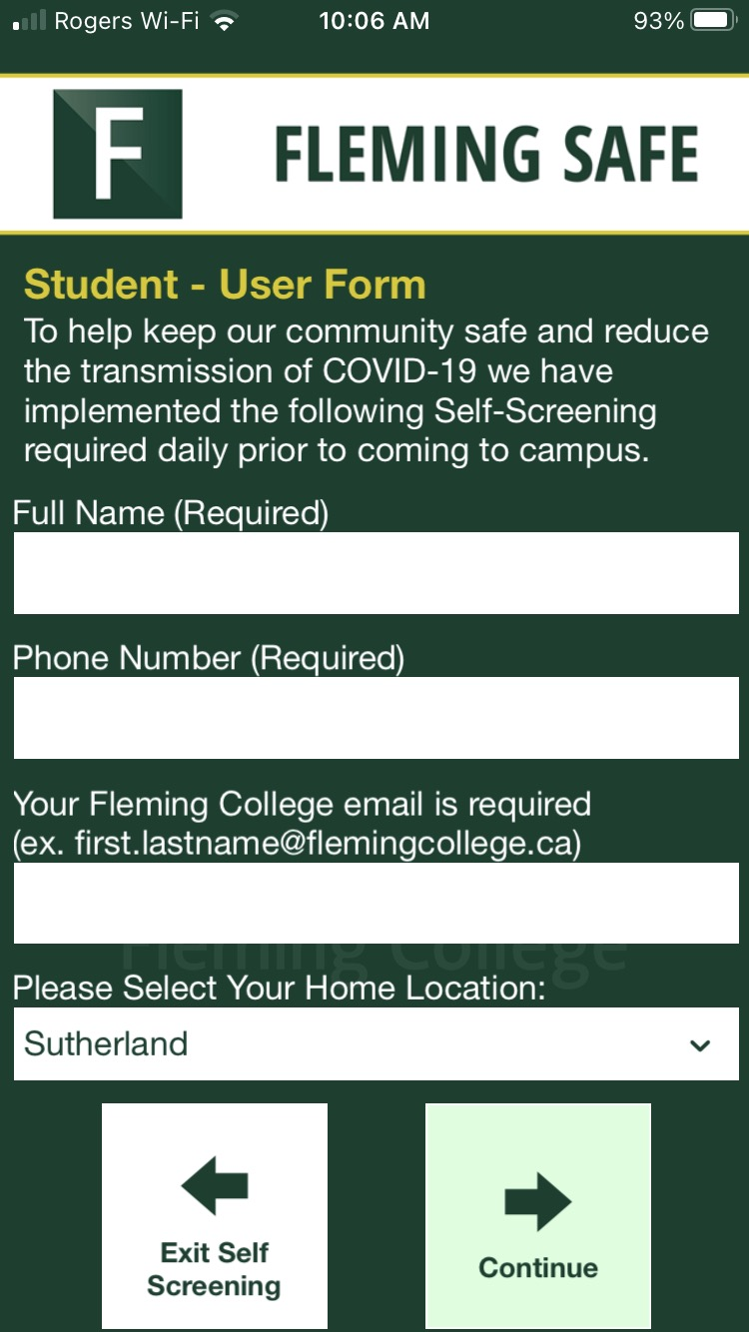
COVID-19 Screening
Notice of Consent
Acceptance required before proceeding with screening
Alternate In Person Screening option provided
Student Information
Information required before proceeding to screening.

Slide 5
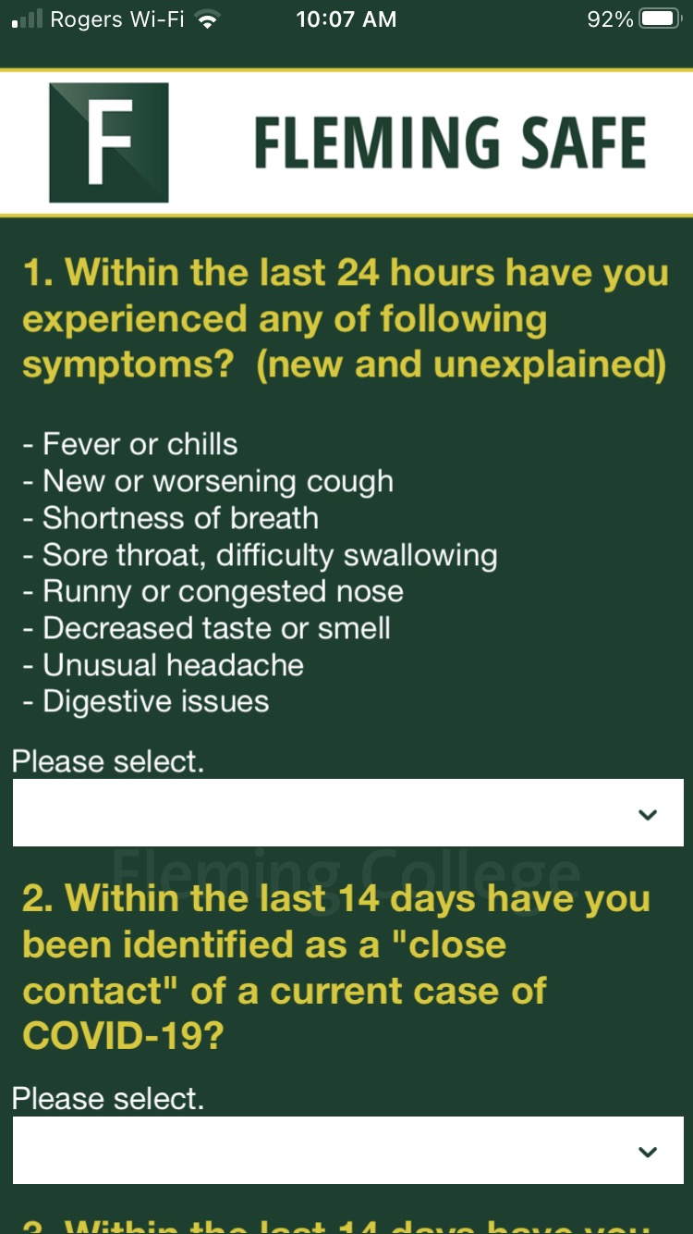
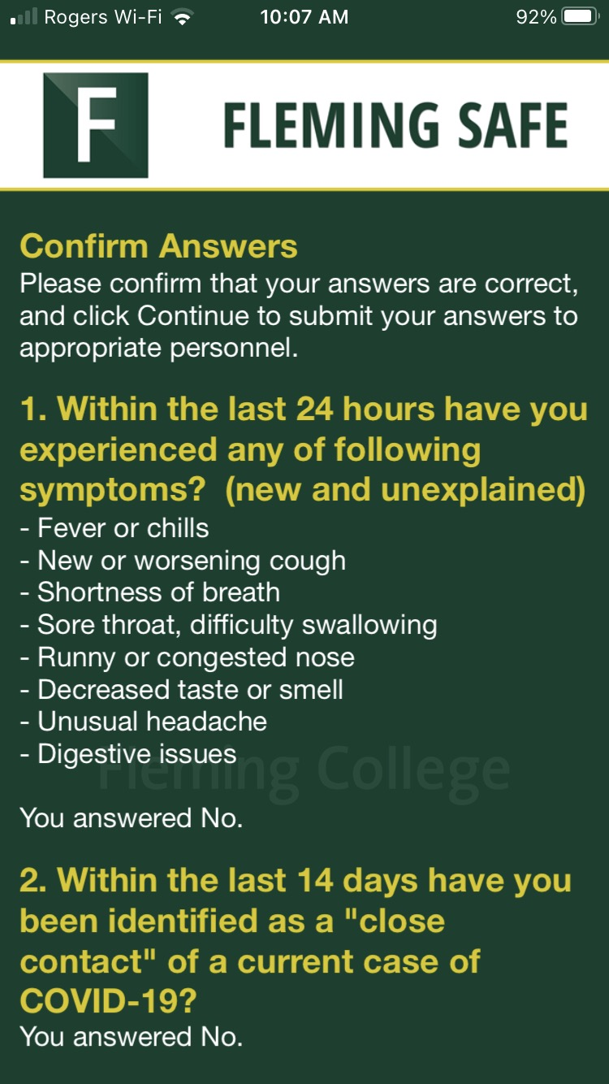
COVID-19 Screening
Answering the following 4 self-screening questions
Ensure you have answered all self-screening questions before clicking continue
Once on this page be sure to click continue to submit self-screening questions

Slide 6
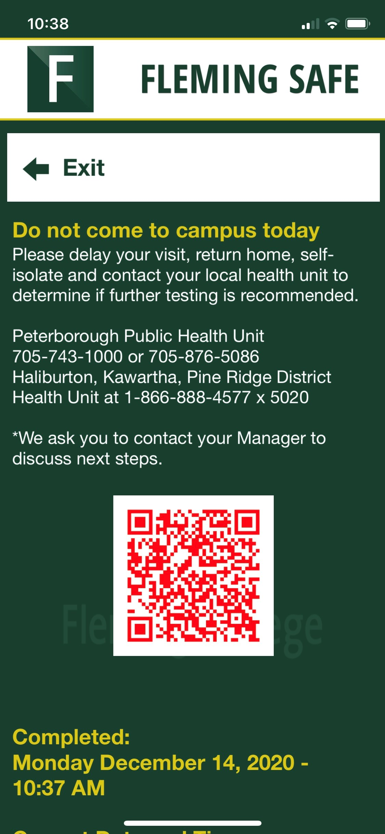
COVID-19 Screening
Self-Screening Results
You will receive a pass or fail badge and an email confirmation.
If you fail the self-screening questions, please DO NOT come to campus, proceed home and contact your local health unit.

Slide 7
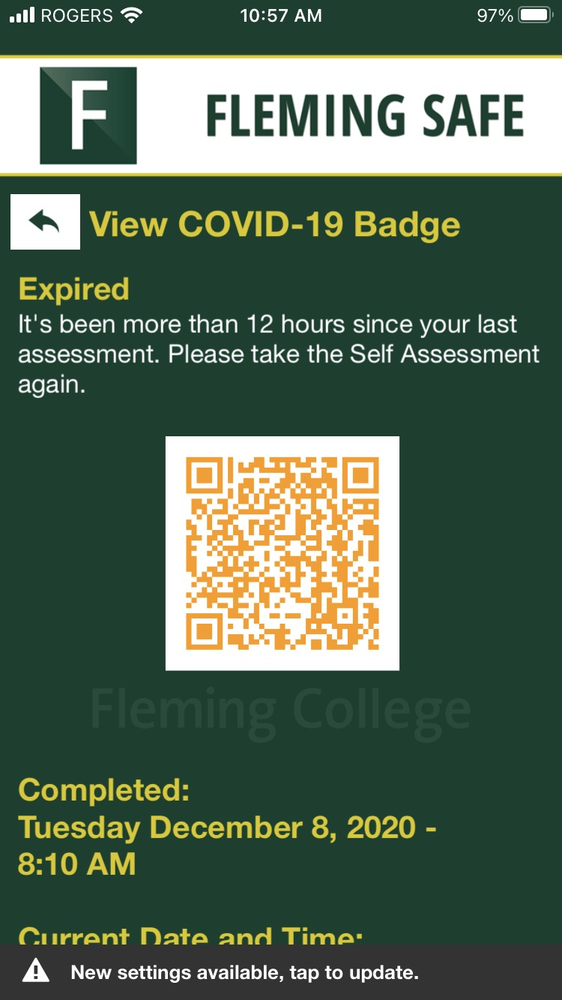
COVID-19 Screening
Expired Badge
This badge will appear 12 hours after your last self-assessment. Once it is expired you will need to take the self-assessment again. The self-screening questions are to be answered daily, if going to campus.

